Slide 1
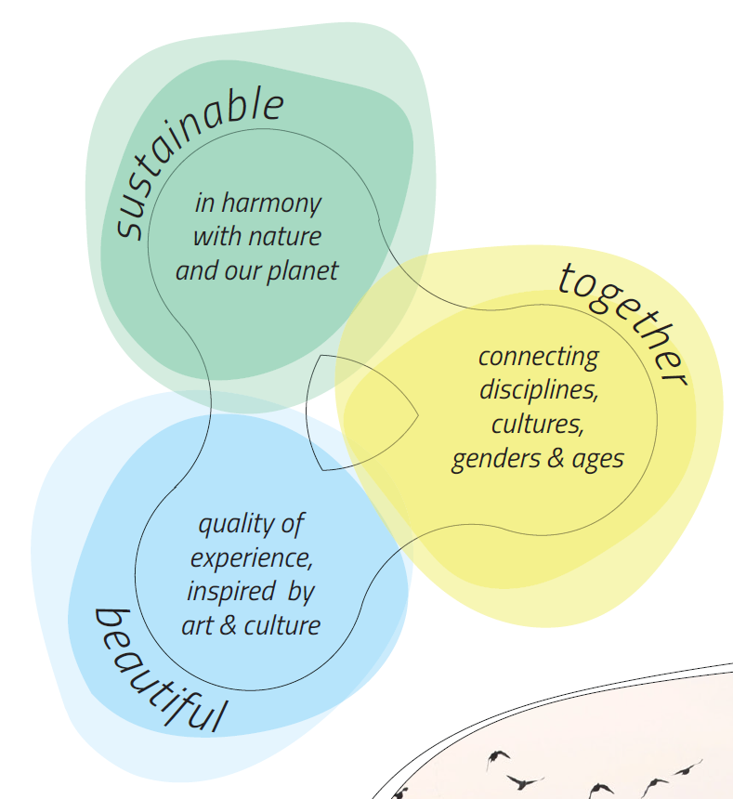
New European Bauhaus From vision to action Ruth Reichstein
https://europa.eu/new-european-bauhaus/about/about-initiative_en

Slide 2
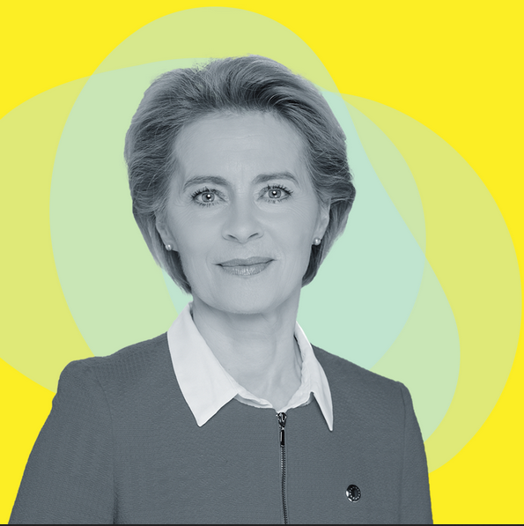
“If the European Green Deal has a soul, then it is the New European Bauhaus which has led to an explosion of creativity across our Union.” Ursula Von der Leyen, President of the European Commission

Slide 3
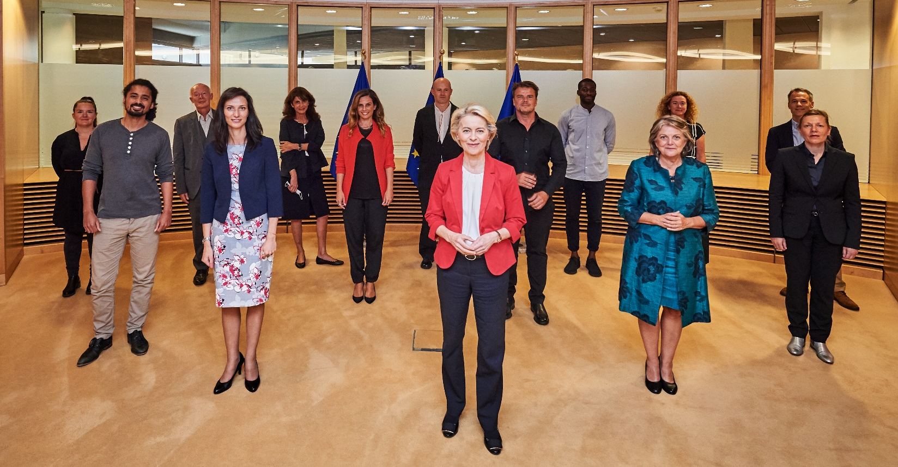
A growing community
HLRT members, Partners, Friends, National Contact Points, Prize finalists, beneficiaries of calls

Slide 4
9 to 12 June 2022 as a hybrid event
The core activities took place in Brussels, with 200 satellite events across the EU and beyond.
Total attendance of over 170.00 people
Total reach of millions of people in- and outside Europe
Discussions on key topics such as rebuilding of Ukraine, regenerative design in the built environment, EUGreenDeal
https://new-european-bauhaus-festival.eu

Slide 5
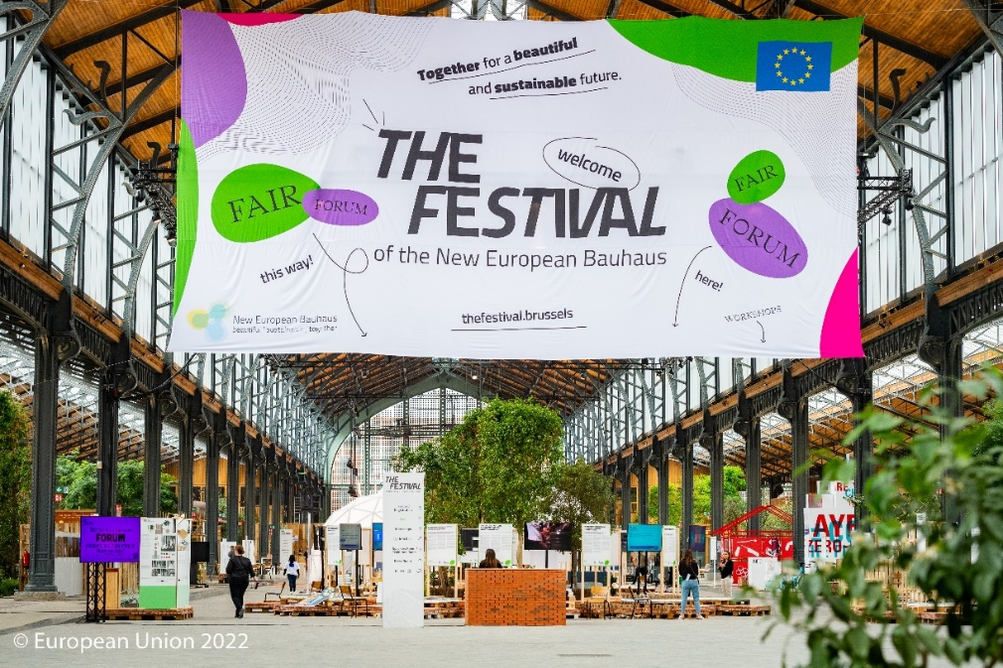
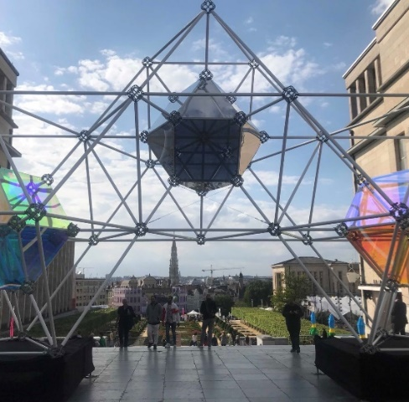
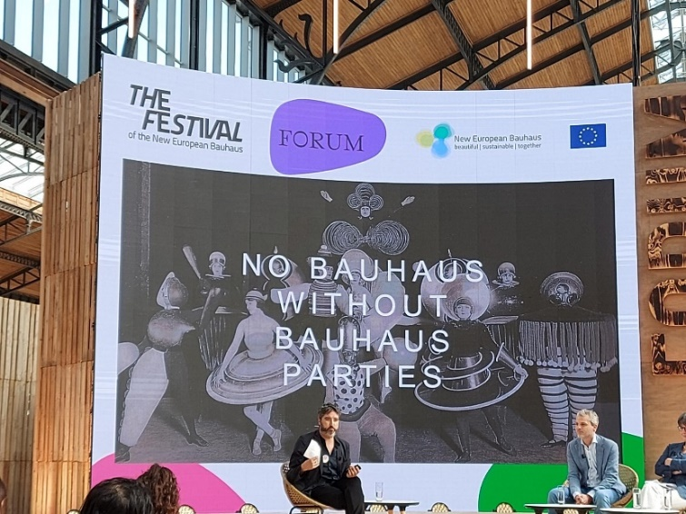
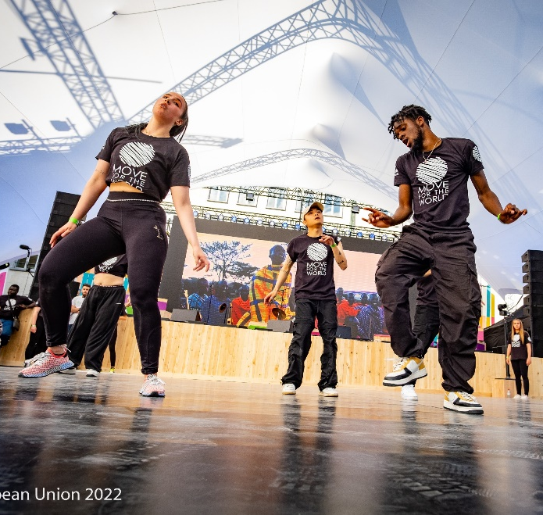
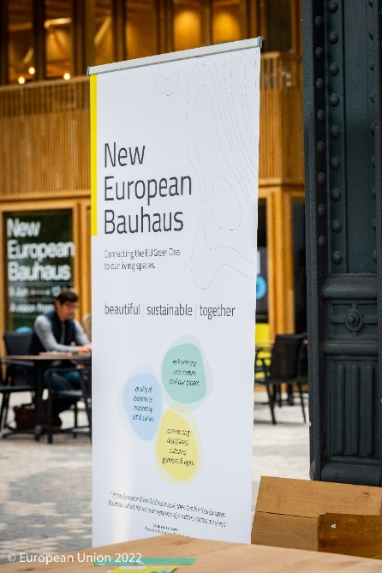
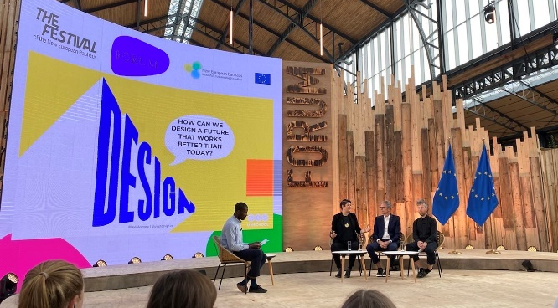
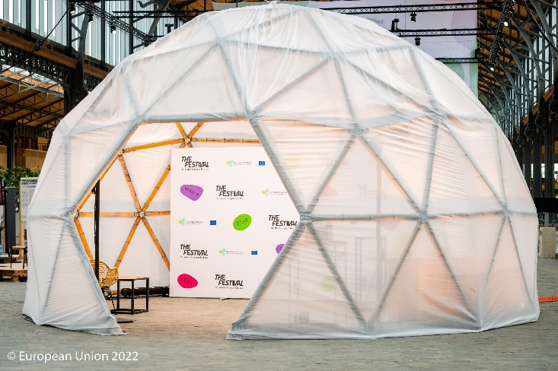
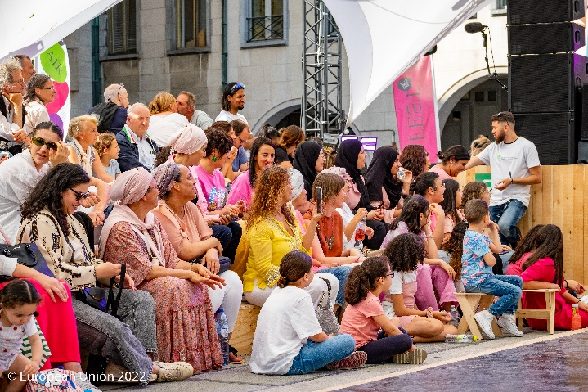
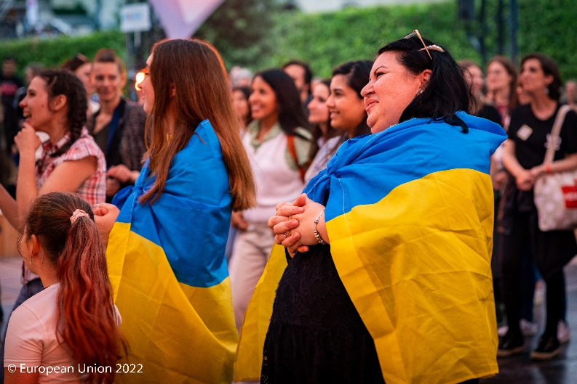

Slide 6
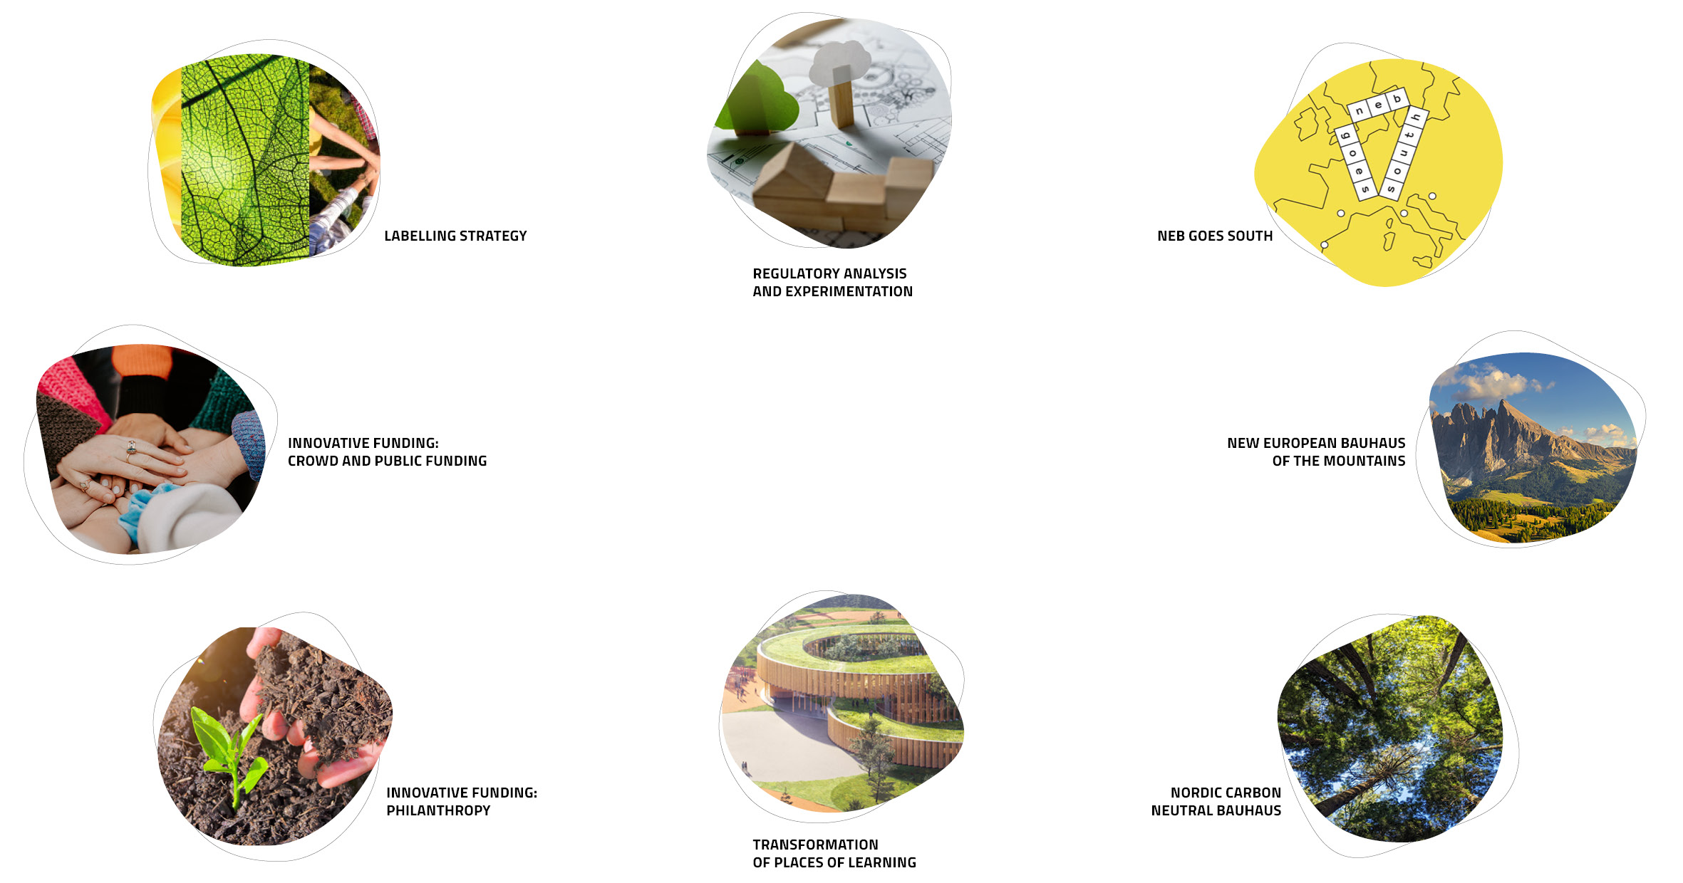
NEB Lab
https://europa.eu/new-european-bauhaus/about/neb-lab_en
More information: https://europa.eu/new-european-bauhaus/about/neb-lab_en
https://europa.eu/new-european-bauhaus/about/neb-lab_en

Slide 7
Labelling strategy supports the definition, identification and development of New European Bauhaus transformation projects.

Slide 8
Regulatory analysis and experimentation explores how the regulatory framework on European, national, regional or local level can support the development of New European Bauhaus projects.

Slide 9
Share your experience with local to EU legislation in the built sector
Take the survey
Share an existing report (study, policy or scientific paper)
by 30 June 2022
Notes:
Codesign, effort

Slide 10
Role of Engineers
Our objective: impact on the ground
Challenge → Idea/vision → technology → solution embedded on the ground
Engineers occupy crucial intersections between concept and product, between idea and embedded solution
The NEB needs problem solvers and innovators!
→ Join the Community and become a partner or friend of the New European Bauhaus

Slide 11
5 projects
13 locations, EU & beyond
€25 million funding
https://ec.europa.eu/commission/presscorner/detail/en/ip_22_2780

Slide 12
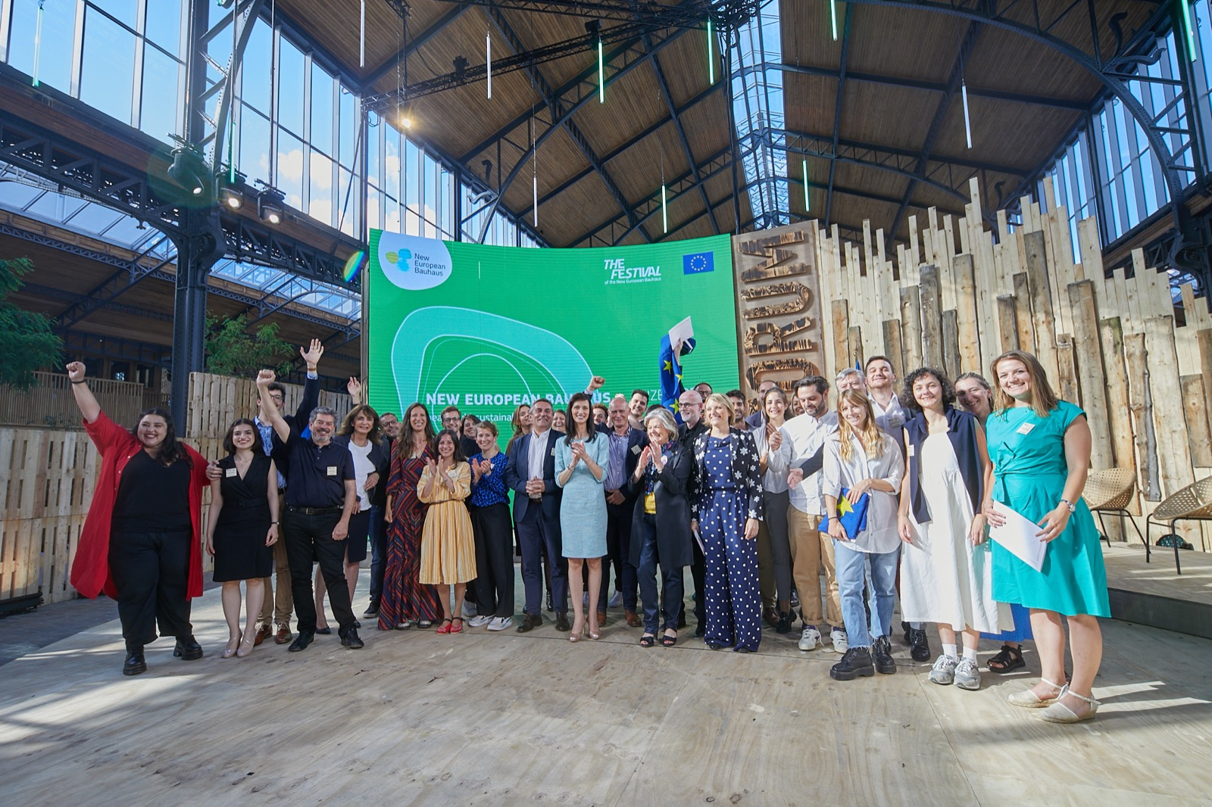
New European Bauhaus Prizes 2022

Slide 13
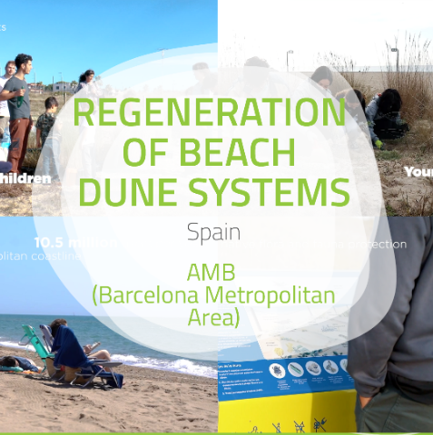
Winners of New European Bauhaus Prizes 2022

Slide 14
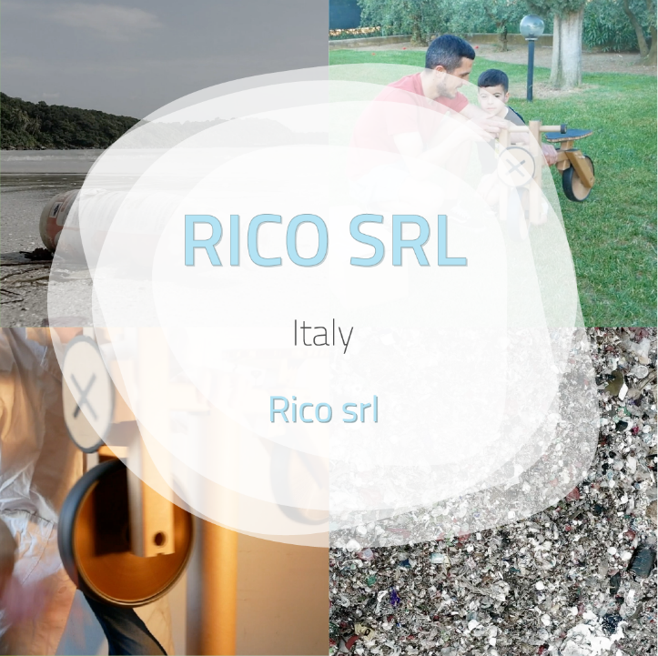
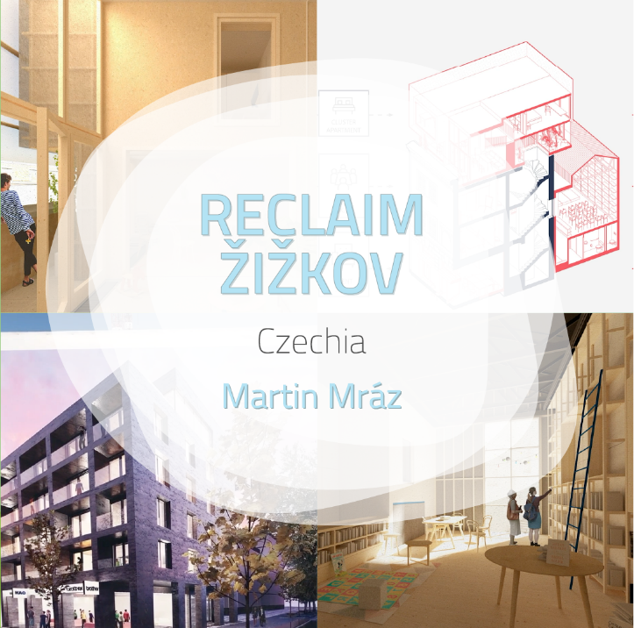
Runners up of New European Bauhaus Prizes 2022

Slide 15
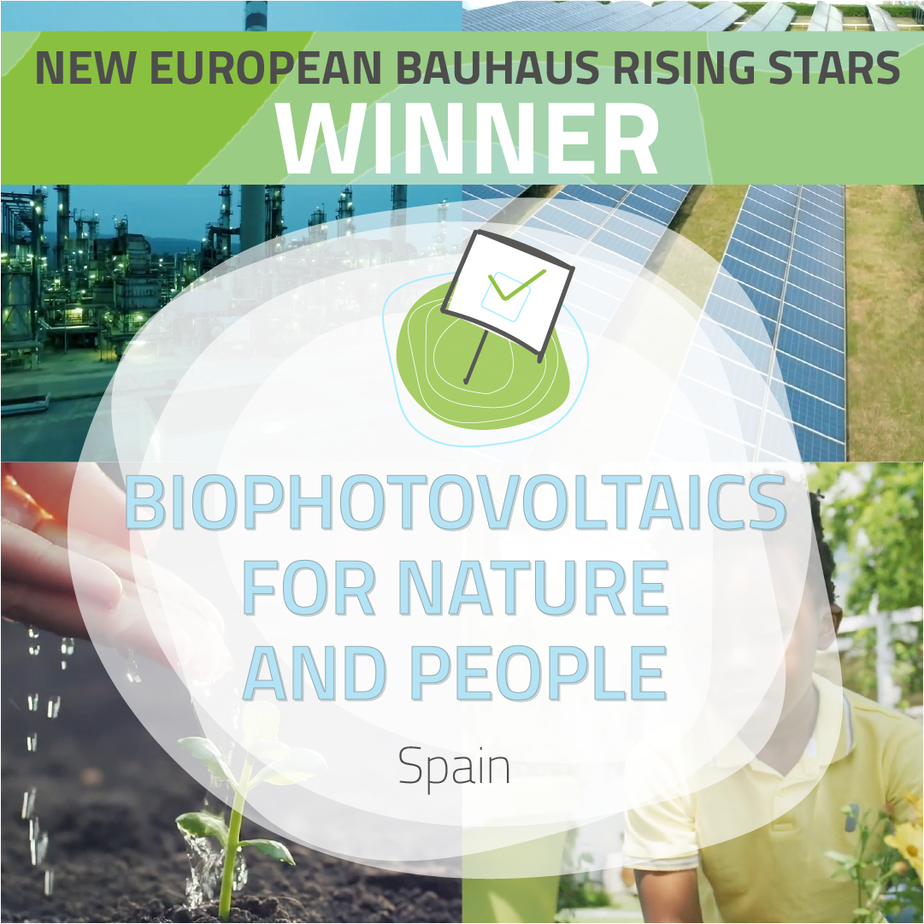
Public vote winners of New European Bauhaus Prizes 2022

Slide 16
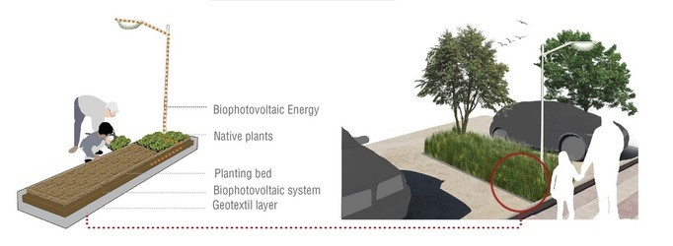
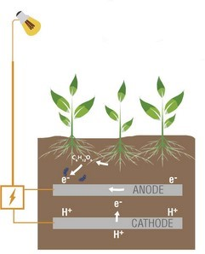
NEB Prize Winner 2022 Public Vote “Rising Stars”
©Alberto López Burzaco
Using biophotovoltaics to obtain clean and inexpensive energy to power a city’s electric urban furniture
©Alberto López Burzaco

Slide 17
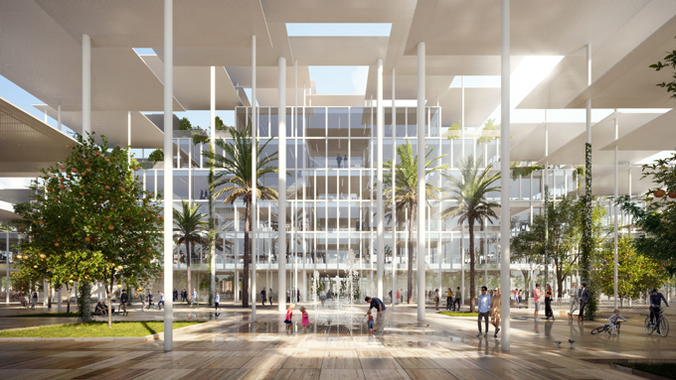
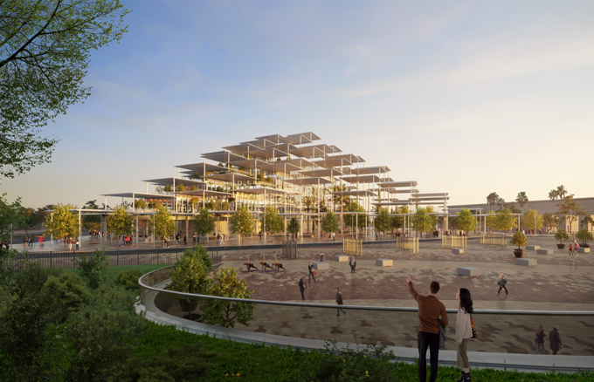
New European Bauhaus inspired architectural contest
Future Joint Research Centre in Seville
https://europa.eu/new-european-bauhaus/new-european-bauhaus-inspired-future-jrc-site-seville_en

Slide 18
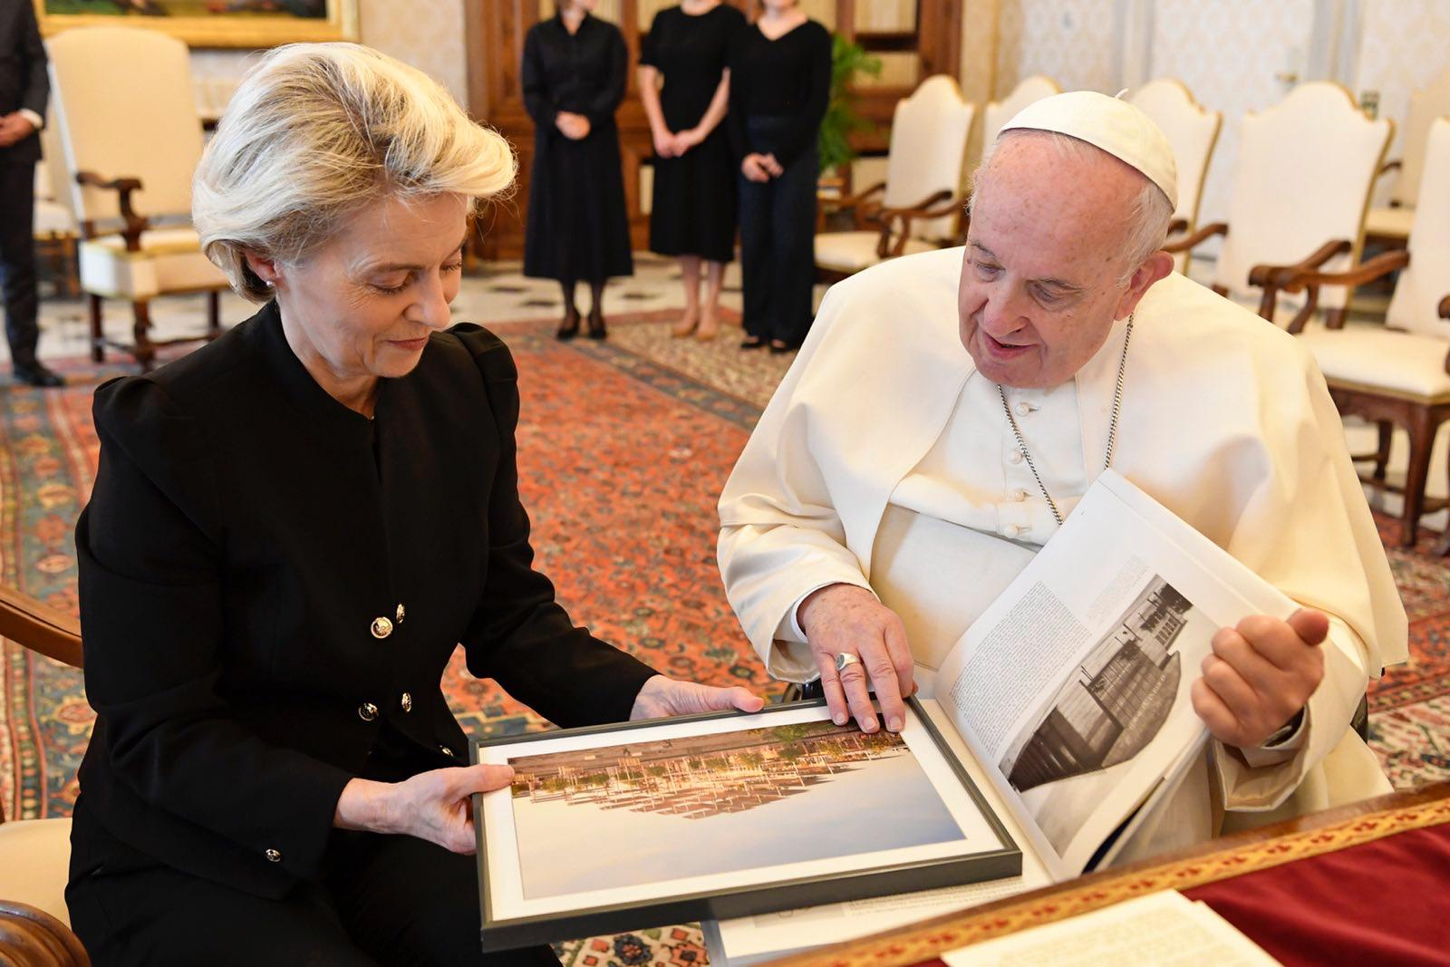

Slide 19
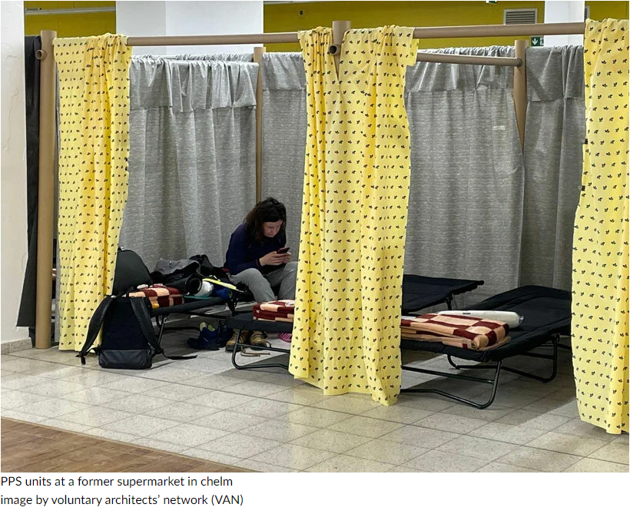
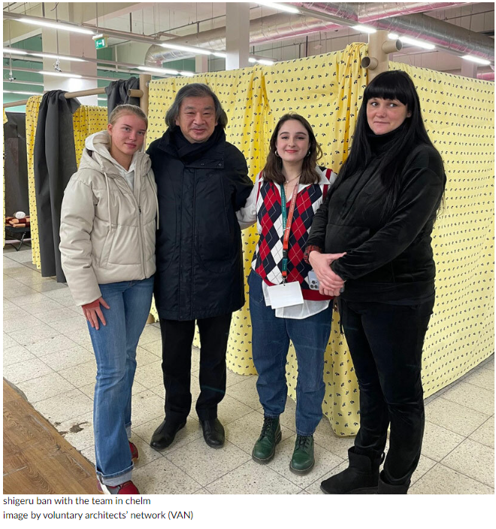
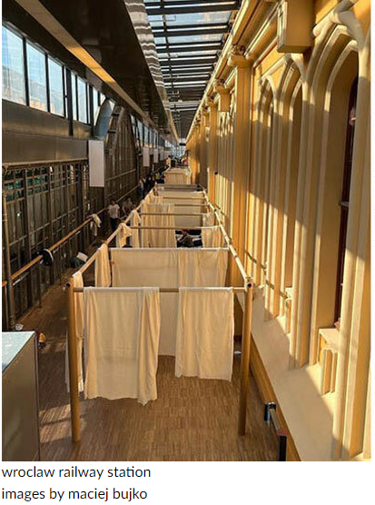
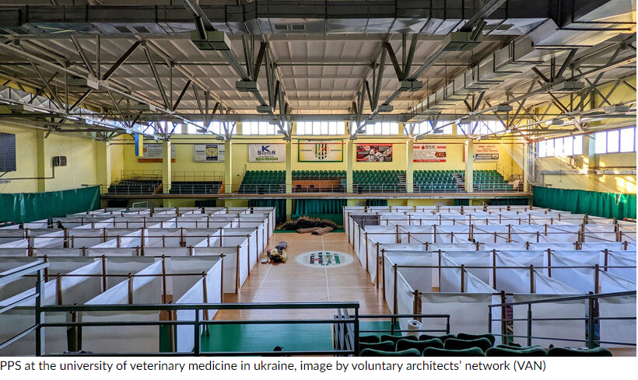
Standing with Ukraine Short-term: mobilisation of support for refugees
Long-term: reflection about post-war reconstruction

Slide 20
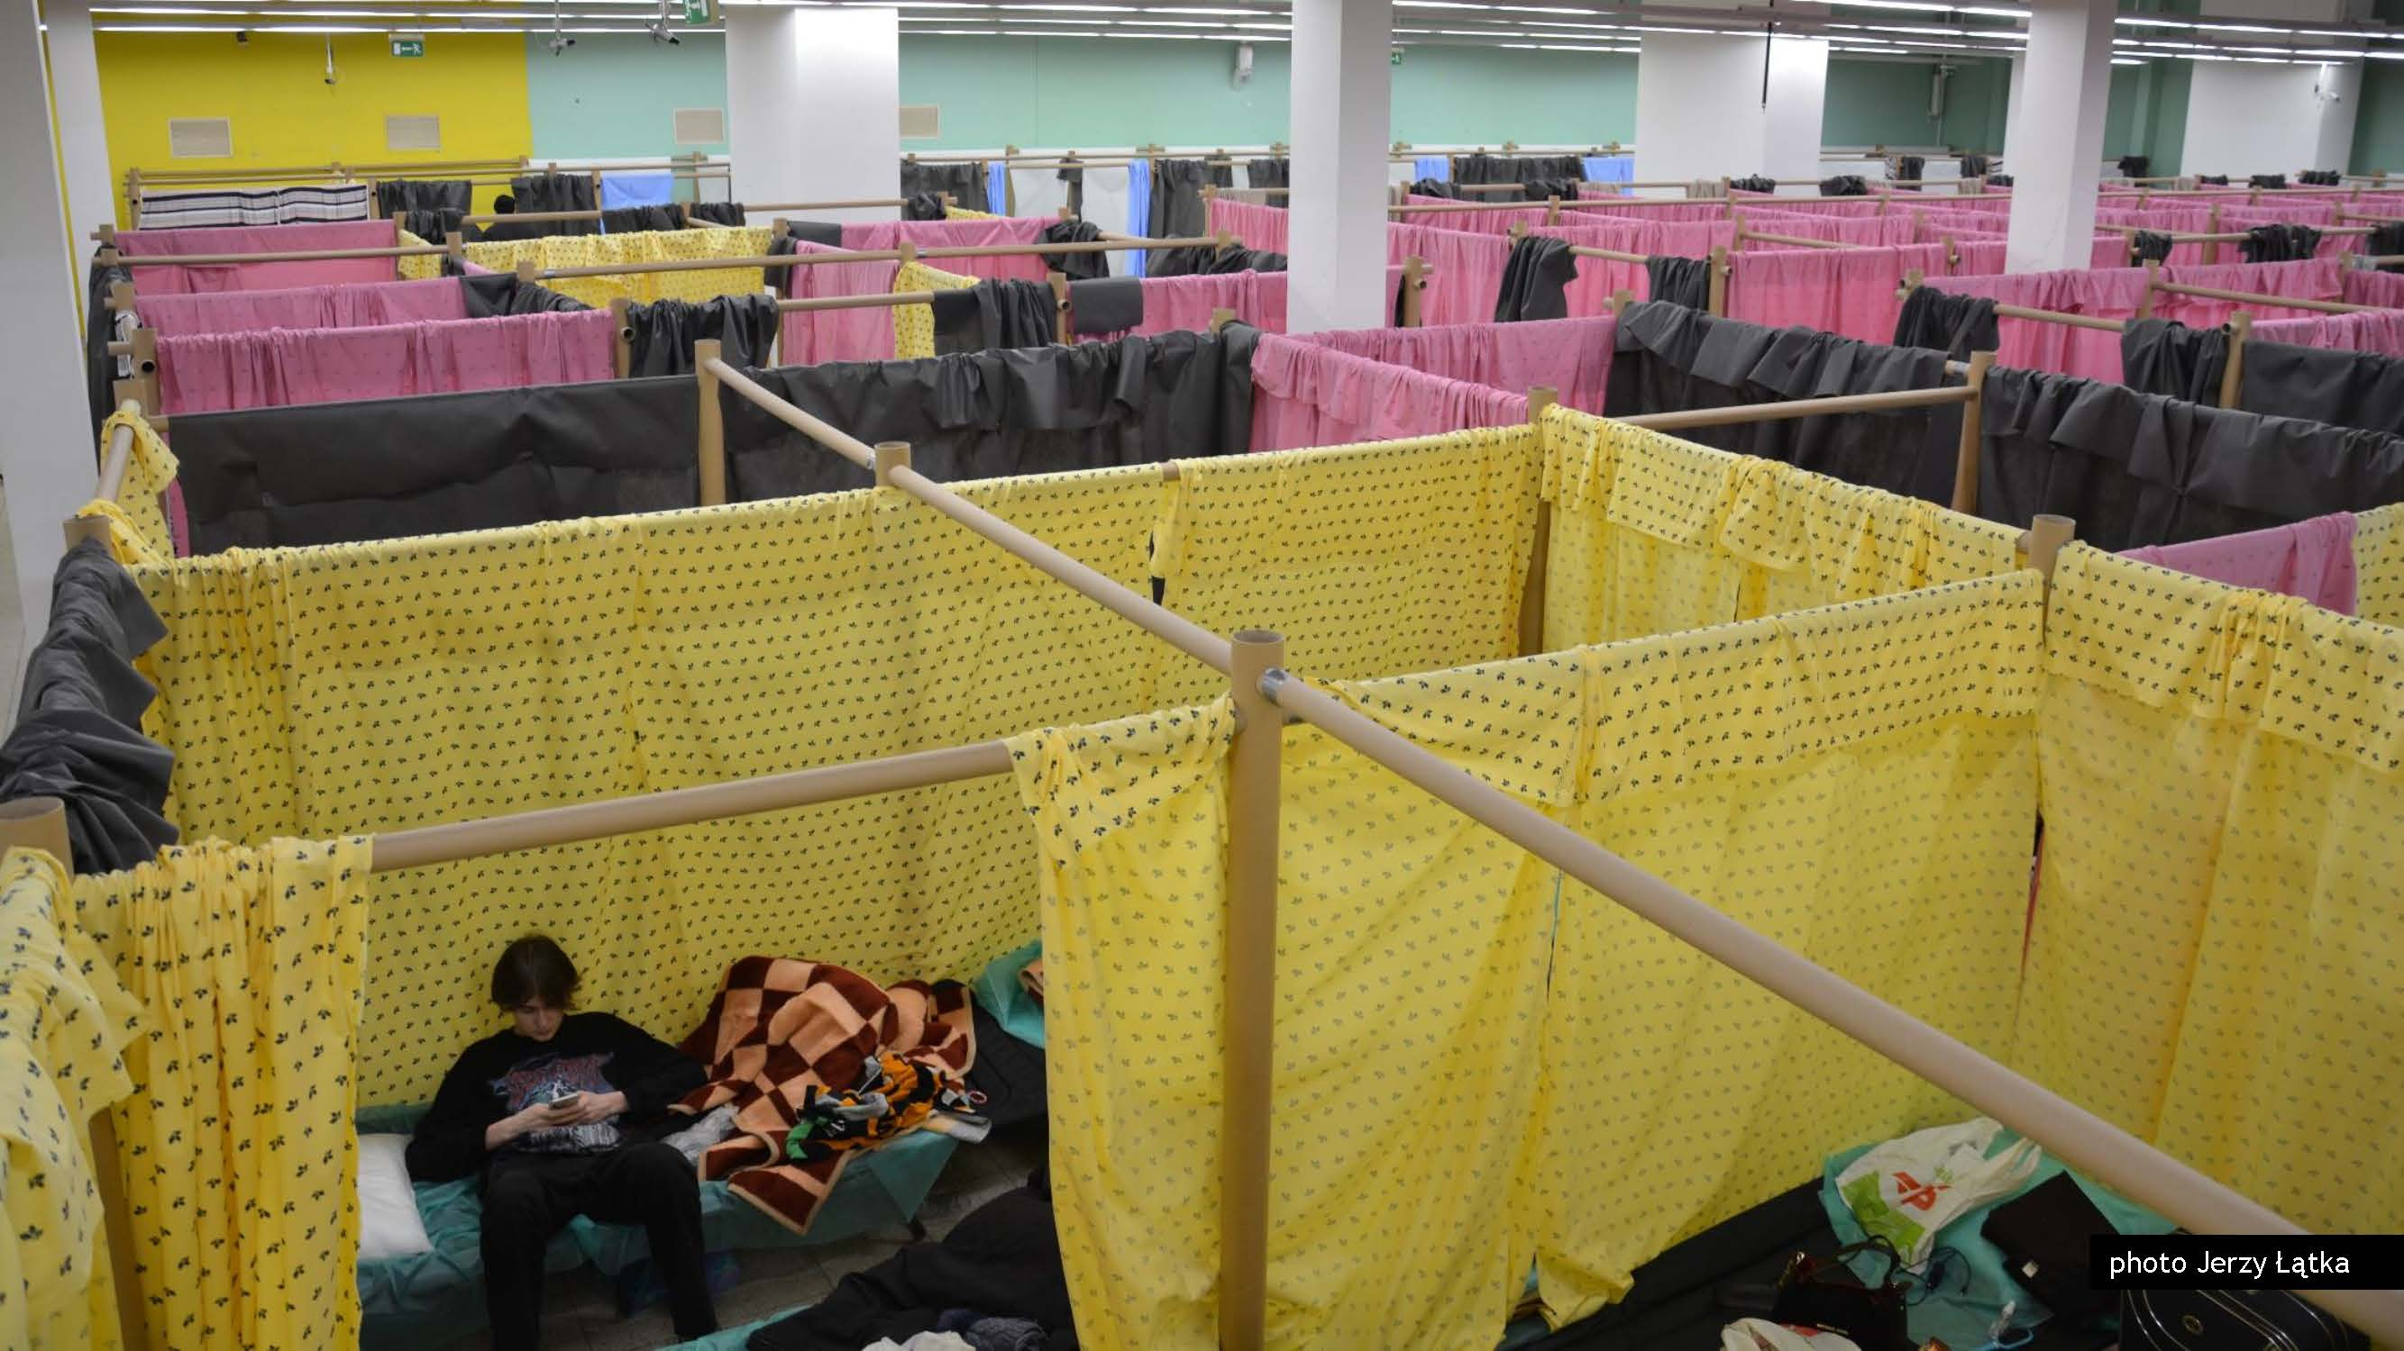
Ukraine
Paper partition shelters for Ukrainian refugees installed by Shigeru Ban, Japanese architect and member of New European Bauhaus High-level roundtable (HLRT). Quick roll-out in MS coordinated with other HLRT members Mária Beňačková Rišková and Hubert Trammer.

Slide 21
"We will reconstruct Ukraine. It is not only in our interest, but it is our moral duty. When we do it, let's do it in the right way. Let's do it in the spirit of the New European Bauhaus." Ursula Von der Leyen, President of the European Commission

Slide 22
Thank you !

