Slide 1
New European Bauhaus and Sustainable Cities
Lean Doody, Arup
Director Cities, Planning & Design, Europe
Notes:
Sorry can‘t be with you in person
What NEB means to Arup as engineers, designers, policy advisors to cities
Bauhaus themes and illustrate with some European projects we have worked on
Explain New European Bauhaus relevence to sustainable cites
Latest challenges and NEB help?
Define topics – collab/buy-in, place-based, NbS, renovations
Project 1
Project 2
Project 3

Slide 2
Arup
Arup and Sustainable Cities
Sustainability is everything
Bauhaus founder, Walter Gropius, greatly influenced Ove Arup’s team-spirited vision for design and the creative, inventive qualities of both engineers and architects.
Notes:
We are v interested and excited about NEB
Our founder cooresponded with Walter Gropius– Total Architecture- Total Design– where many disciplines come together for better design outcomes
For those who don’t know us, we are a multi-national company who delivered some of the most prominent projects across the built env
Sustainable development is at the core of what we do
Arup is the creative force at the heart of many of the world’s most prominent projects in the built environment and across industry. We want sustainable development to simply become what we do. We have a decade to make a difference and need to start now.
And it engrained in our culture – our founder – Ove Arup – shaped his vision for the firm after the principles of the Bauhaus putting creativity / functionality and social value at the core of it

Slide 3
New European Bauhaus
Key Attributes
Cultural, Human-Centred, Positive and Tangible
Three Pillars
Enriching
Sustainable
Inclusive
Thematic Axes
Regaining a sense of belonging
Prioritising places and people that need it most
Fostering long-term, life-cycle and integrated thinking
Reconnecting with nature
source: European Commission
Notes:
In terms of delivery, the key attributes of the NEB are outlined which are informed by three inseparable values of enriching/sustainable/inclusive. Four thematic axes guide the initiatives implementation.
These key themes take inspiration from the views and experiences of thousands of citizens, professionals and organisations across the EU who joined the co-design of the initiative and the open conversation about rethinking the way we live together.
The following cases each reflect themes within the three pillars – namely green and NbS, renovation and co-creation....
https://europa.eu/new-european-bauhaus/about/delivery_en

Slide 4
Theme 1: Enriching
Nature-based Solutions for climate change adaptation and disaster risk reduction can be considered an 'umbrella concept' encompassing a range of established nature-based approaches, which aim to increase resilience to climate change.
Notes:
Nature-based Solutions for climate change adaptation and disaster risk reduction can be considered an 'umbrella concept' encompassing a range of established nature-based approaches, which aim to increase resilience to climate change.
Nature-based Solutions (NbSs) are living and dynamic systems that require careful considerations both in design and operation. Data-driven design as well as the engagement and the active role of citizens are crucial elements for their successful implementation.

Slide 5
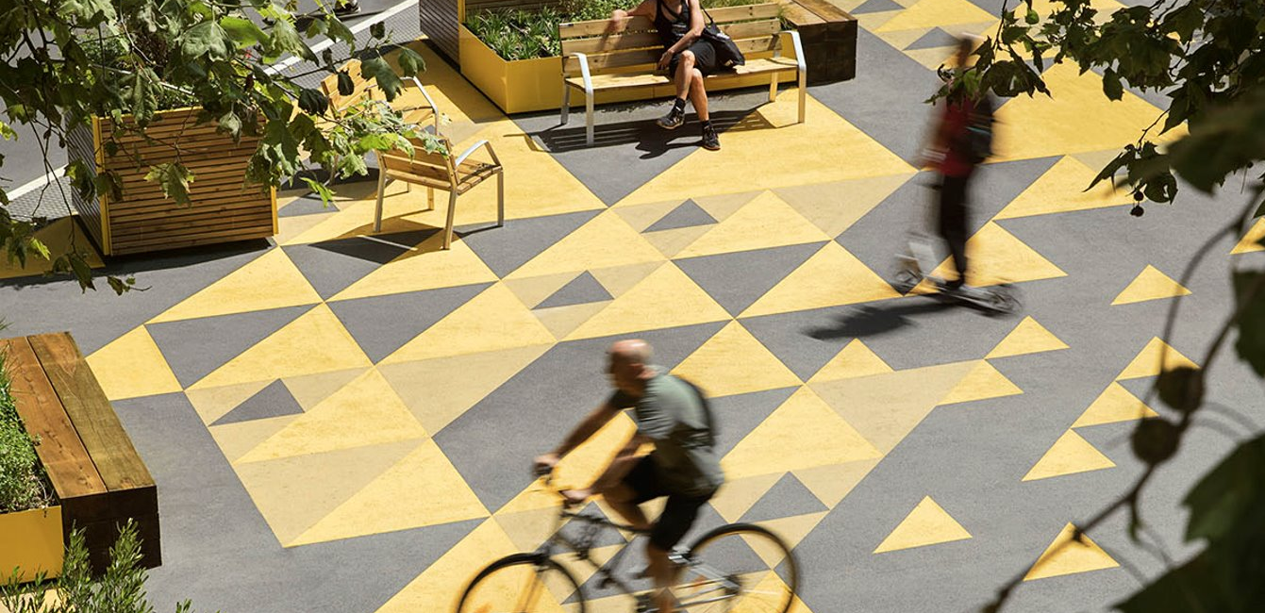
Green and Thriving Neighbourhoods​| C40 & Arup
Harnessing a model for low-carbon urban development that is human-scale, thriving and inclusive for our future .
Notes:
Neighbourhoods provide an ideal scale and context for equitable and sustainable recovery and an opportunity to develop replicable, net zero approaches that can be deployed city-wide and beyond.
Green and Thriving Neighborhoods is a guidebook to support the harnessing a model for low-carbon urban development that is human-scale, thriving and inclusive for our future.
Developed by Arup and C40, it provides cities, as well as national governments, private sector developers, residents and communities, with the framework and approaches to develop ambitious net zero and people-centred neighbourhoods that showcase today the future we want to see.
Based on two concepts of Green and Thriving. Green refers to net-zero emissions, whereby throughout the project lifecycle the aim is to minimise emissions and achieve net-zero by counteracting any residual emissions in a robust and transparent way. Thriving refers to a resilient and people centred approach where the essential needs of residents are met at the neighbourhood scale. This pillar supports ‘human scale’ local life which encourage healthy sustainable lifestyles and prepares people to adapt and prosper in light of the climate shocks and stresses faced.

Slide 6
Green and Thriving Neighbourhoods​| C40 & Arup
A guidebook was developed that outlines ten approaches for acheiving green and thriving neighbourhoods.
Complete neighourhood
People centred mobility
Connected place
A place for everyone
Clean construction
Green buildings and energy
Circular resources
Green & nature based solutions
Sustainable lifestyles
Green economy
A strategic development pathway activates the outlined approaches.
Prepare the project
Establish a baseline
Set the vision
Determine the actions
Plan to implement
Notes:
A guidebook was developed that outlines ten approaches for acheiving green and thriving neighbourhoods.
Complete neighourhood
People centred mobility
Connected place
A place for everyone
Clean construction
Green buildings and energy
Circular resources
Green & nature based solutions
Sustainable lifestyles
Green economy
1. Prepare the project​
Make a commitment to invest in a site, identify the key stakeholders who will lead the vision and be accountable for success and establish partnering arrangements. ​
​
2. Establish a baseline​
Develop an understanding of the broader context of the site, such as the surrounding environment, land use and open space, transport and utilities connections, and social and economic conditions. Use this to identify the key issues which need to be resolved and the various elements that could act as catalysts of change. Calculate an initial emissions baseline and determine the main quality of life indicators.​
​
3. Set the vision​
Establish a clear vision, objectives and targets for the neighbourhood. These set a framework to guide the development cycle from concept and design development through to implementation, construction and operation. Use the vision to build consensus among stakeholders and to establish a framework for measuring success.​
​
4. Determine actions​
Achieve the vision, objectives and targets by establishing key actions, responsibilities and accountabilities for planning, design, development and operation of the neighbourhood. Prioritise the ‘Ten Approaches’ and incorporate into the action plan.​
​
5. Plan for implementation​
Agree financing, policies, partnerships and contracting arrangements that need to be established to deliver long-term successful outcomes.​

Slide 7
Tirana Orbital Forest​| Tirana, Albania
A project that addresses the need for greening in Tirana, in response to issues such as poor air quality, flood resilience and
urban heat.
Notes:
The project is a follow-on investment from Tirana’s Green City Action Plan (GCAP), developed through the city’s participation in the EBRD Green Cities programme.
In Tirana, Albania, a city that has seen rapid development since the early 1990s, there’s a clear need for a green reboot. Traffic congestion and pollution, poor air quality, flood resilience, urban heat, low green space per capita, and the effects of urban sprawl have come to challenge life in the capital.
Arup is supporting Tirana to build both the economic and technical case for the Tirana Orbital Forest, bringing landscape architects, ecologists, climate change specialists and economists together to assess the whole value case for our clients: Tirana and the European Bank of Reconstruction and Development (EBRD), which is considering a loan to support the project. Arup’s work includes quantifying the wider environmental and economic benefits that the forest will bring such as improved resilience to floods, human health benefits from improved air quality to increased local economic activity and tax revenues stimulated by the provision of new recreational facilities.

Slide 8
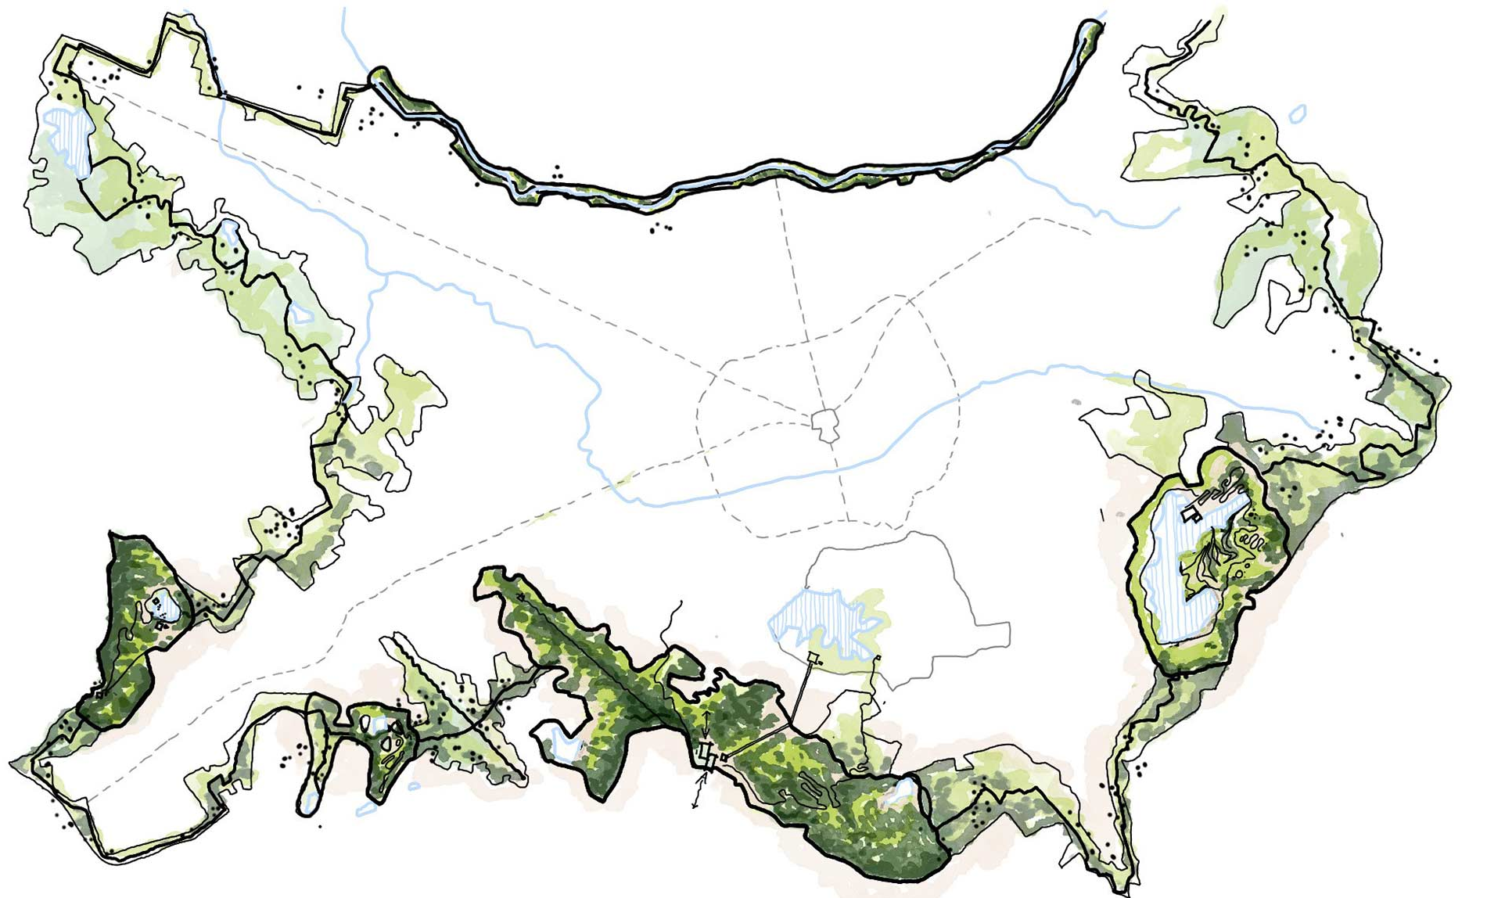
Tirana Orbital Forest​| Tirana, Albania
Looks to demonstrate the value of investing in green infrastructure or NbS for resilience
A proposed ring around the urban perimeter of the city with a mix of forests, shrubland, agricultural land and recreational areas
Key principles:
to protect existing landscapes
connect people and ecology
restore degraded landscapes and habitats
provide places for people
Notes:
Tirana Orbital Forest is a project that looks to demonstrate the value of investing in green infrastructure or NbS, as well as grey infrastructure for resilience.
The forest - a proposed ring around the urban perimeter of the city with a mix of forests, shrubland, agricultural land and recreational areas – is a nature-based solution that is intended to put a brake on urban sprawl, reconnect the citizens with nature, clean the air, address urban heat effects, and is just one part of a wider plan for the city’s future.
The work to date has been to assess the benefits of different forest options and scenarios the city could adopt. Our approach centres around four key principles: to protect existing landscapes, connect people and ecology to and through the Orbital Forest, restore degraded landscapes and habitats, and provide places for people.
Nature-based solutions offer so many different benefits, from storm water mitigation, to improved air quality, promoting biodiversity, and reducing the urban heat island effect. Greenery has a powerfully positive effect on quality of life for people too and adds in this way to the resilience of a city and its people.

Slide 9
Theme 2: Sustainable
Notes:
Renovation is a key topic
Challenges and needs:
Energy retrofit of social housing, while preserving affordability and providing high-quality living environments / Renovation of public buildings
Retrofit of heritage buildings and old town centres, balancing energy efficiency and conservation requirements
Support and development of green construction and green procurement, abridging skills gaps, setting standards and providing incentives
Achieving a sustainable energy transition at scale, with a focus on energy systems of urban buildings and infrastructure
Circular water and waste management systems
Exploring the development and adoption of digital city twins for urban management and decision-making

Slide 10
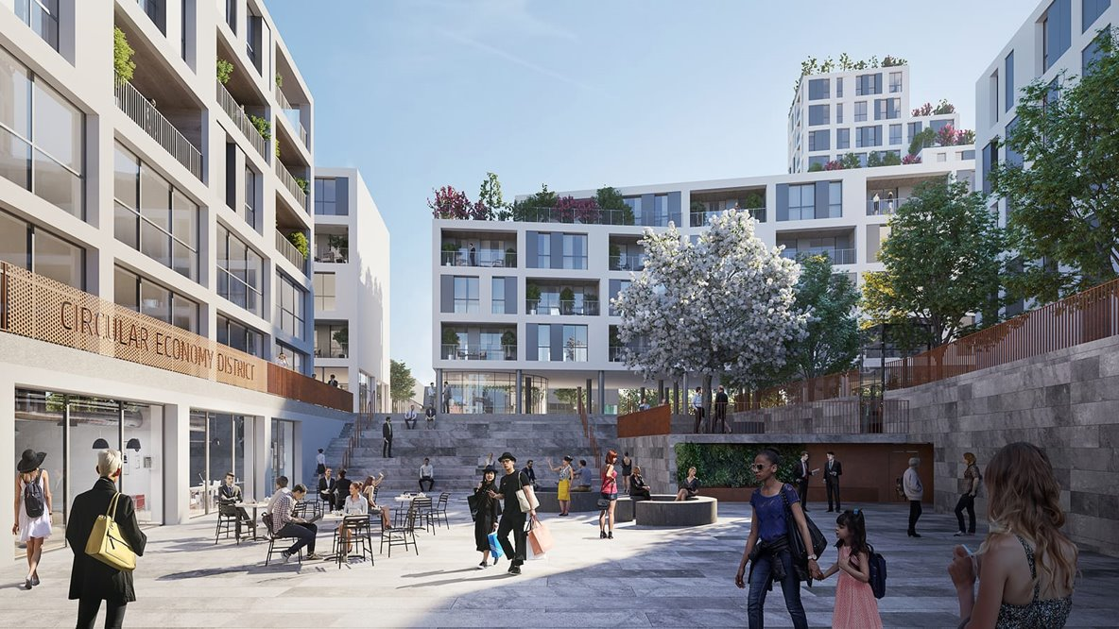
L’Innesto Milan​| Europe
Notes:
The first zero carbon “Housing Sociale” project in Italy. In addition to ultra-efficient buildings and low-carbon heating, L’Innesto will foster sustainable lifestyles.
The neighbourhood app is the platform that provides residents with advice on energy saving opportunities and energy monitoring in homes.
The neighbourhood will create value-added shared spaces for sustainable economic activity and enable relationships between residents. There will be a ‘Zero Waste Store’ and a ‘Community Food Hub’ helping the residents create a long-lasting sustainable community.
This development follows ‘People centred mobility’, ‘Green and nature-based solutions’ and ‘Sustainable lifestyles’.

Slide 11
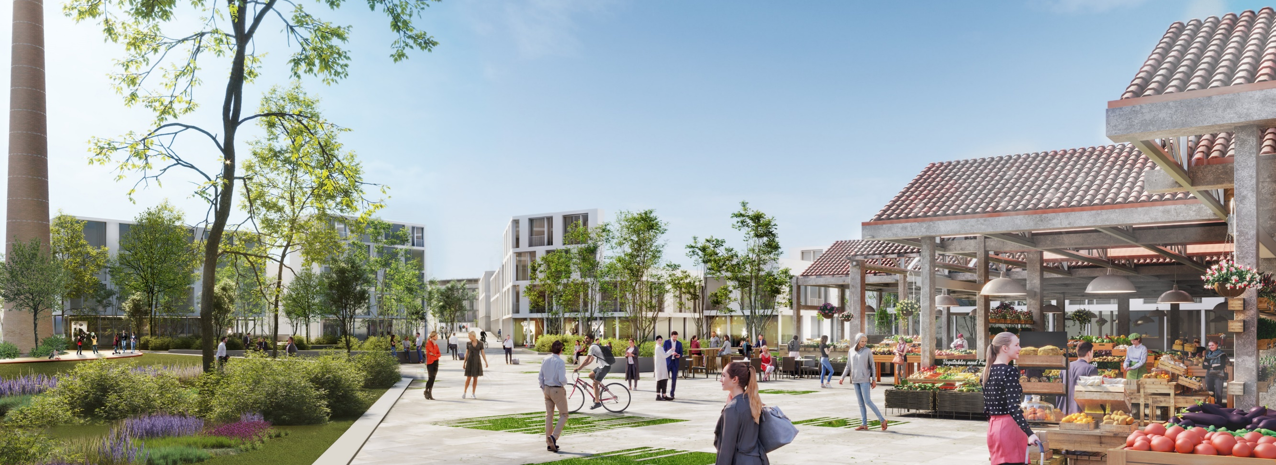
Supernova | Pavia, Italy
The project at a glance
A former industrial site regeneration – Supernova mixed-use masterplan.
Notes:
The intervention area, an ex industrial site ‘Necchi’ (former production of sewing machines) is located close to historical center (just outside the ancient walls north of Pavia) and is about 22 hectares. The urban regeneration vision for a disused industrial site provides a design for a sustainable mixed-use development favouring active transport modes and green infrastructure. The project aims to refurbish some industrial buildings, in order to preserve a sense of place and old memory of the site. Chimney, old warehouses will become new spaces for community (market place, covered plaza etc).
Arup’s masterplan, named Supernova, pays homage to the area’s industrial past as a key manufacturing hub for Italy’s famed sewing machine, the Necchi. Celebrating both its industrial heritage and agricultural surrounds, a pedestrian and bike friendly mixed-use urban regeneration intervention is proposed that includes smart living accommodation and student housing as well as retail, office and a new hotel facility

Slide 12
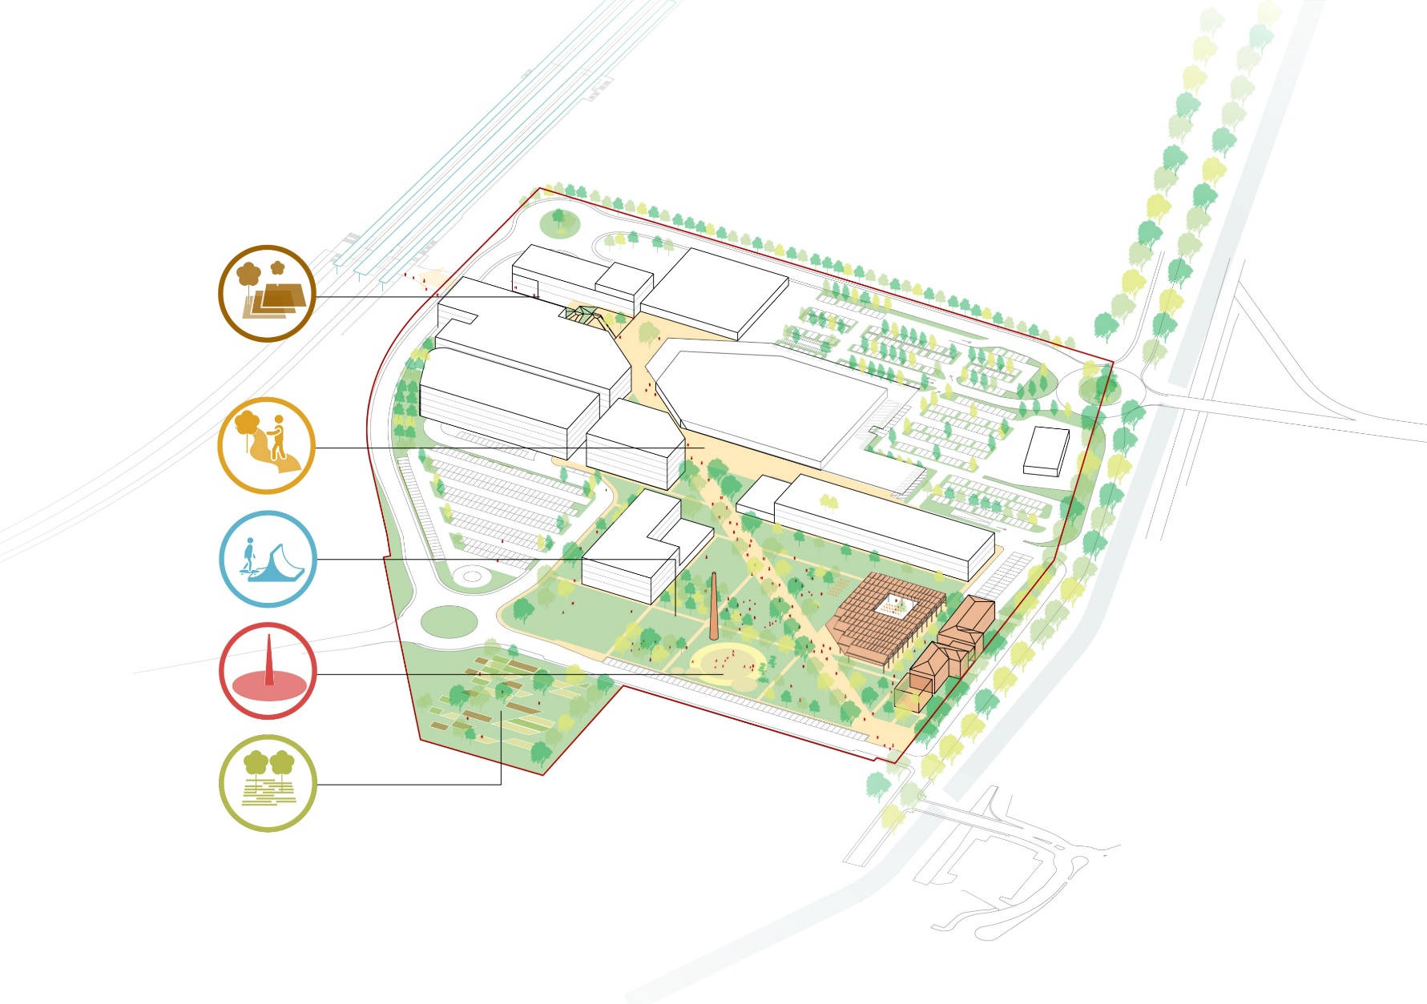
Supernova | Pavia, Italy
What we did and how
Retrofitting of former industrial buildings for public purposes
Creating gathering spaces for local community (community gardens, active public plazas with seasonal program offer, spaces for different age group population)
Bringing new attractive commercial function in order to re-activate abandoned site
Notes:
Former industrial site close to city centre. Today presents as abandoned, not used site. Project aims to ri-active that part of the city by bringing new active functions. Retrofitting of former industrial buildings (Chimney, old warehouses) for public purposes – new seasonal market place, museum of history of ‘Necchi’, spaces for community gathering

Slide 13
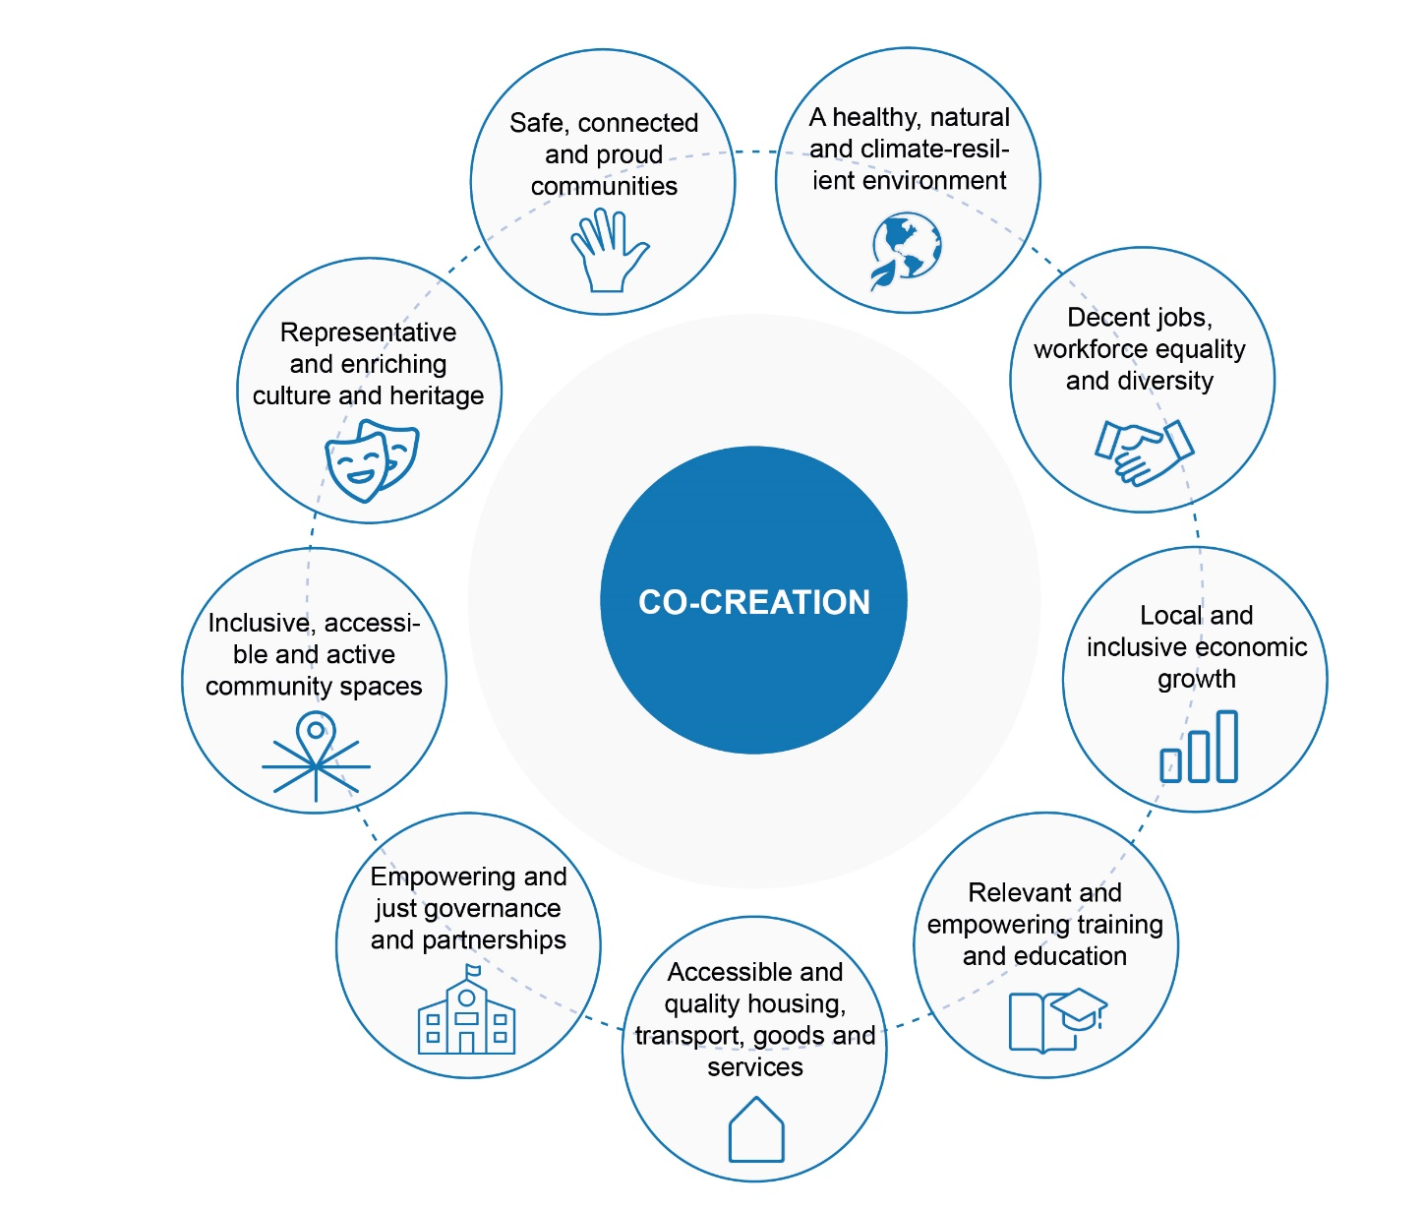
Theme 3: Inclusion
Arup believes that co-creation process is the enduring and systemic change created within communities that leads to improved quality of life for individuals.
Notes:
Pillar 3 is Inclusion, where the theme of co-creation is embodied.
Arup believes that co-creation process is the enduring and systemic change created within communities that leads to improved quality of life for individuals.
Co-creation is a social value process that allows the right physical and non-physical elements be incorporated in the projects.
These elements will vary – and be valued differently - from community to community, project to project, place to place and should be prioritised working with the communities involved.

Slide 14
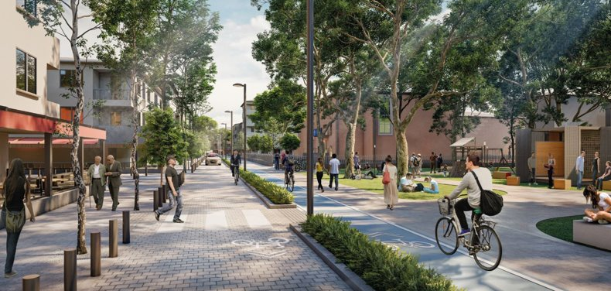
Cankaya Healthy Streets Project| Ankara, Turkey
The project at a glance
A city for everyone: sustainability and inclusion drive the downtown Ankara redesign vision.
Notes:
A city for everyone: sustainability and inclusion drive downtown Ankara redesign vision.
Sustainability drives Çankaya’s ‘Healthy Streets’ Project, which seeks to involve the community to co-design neighbourhood-scale interventions to create a more accessible and inclusive urban environment for the one million local residents.
Inclusivity lies at the heart of the framework, with community engagement a key part of the initial design stage to create a common vision. A wide range of stakeholders were consulted via participatory workshops and gatherings, opening up a democratic and inclusive perspective for the governance practices of local bodies.

Slide 15
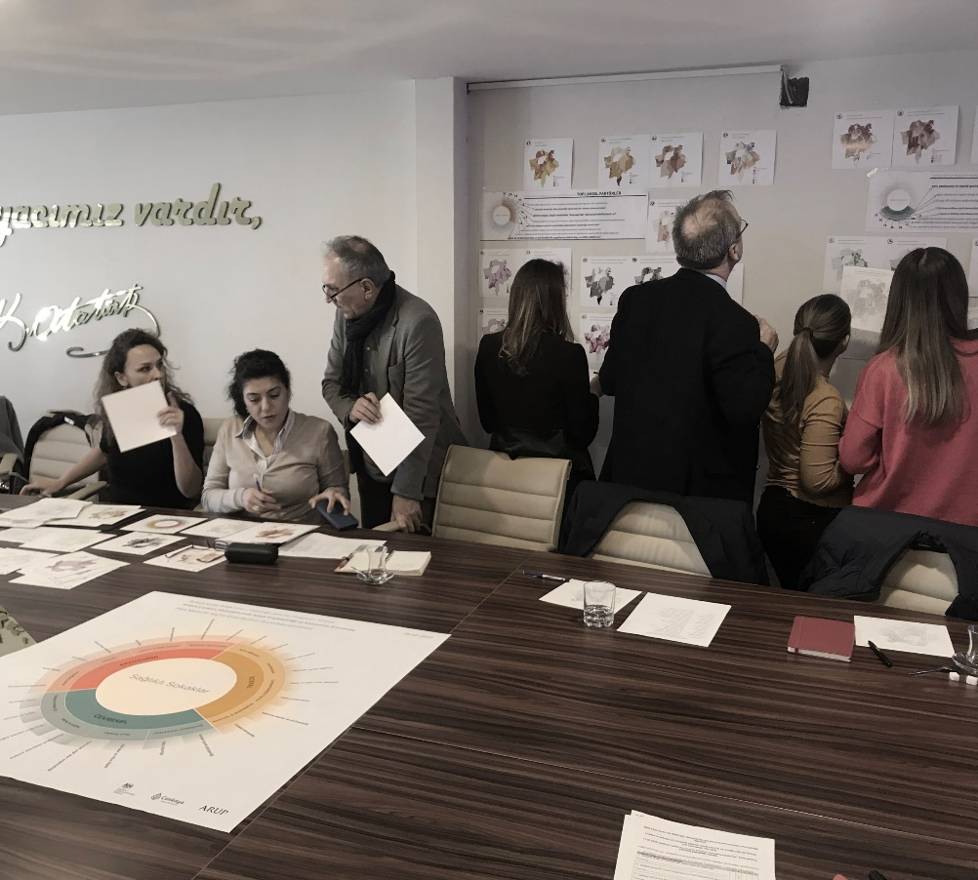
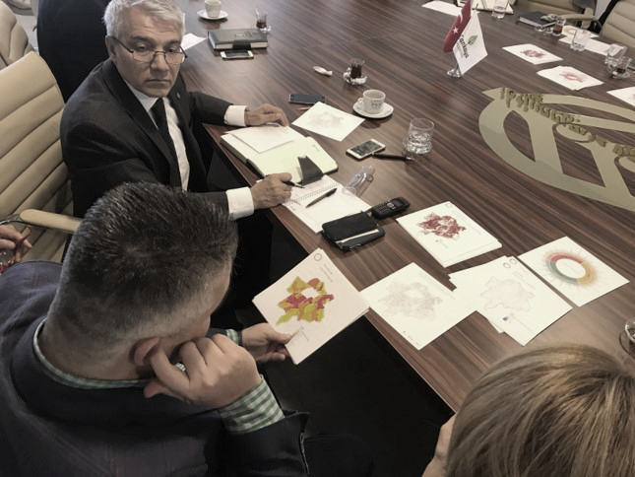
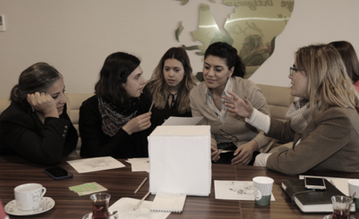
Cankaya Healthy Streets Project| Ankara, Turkey
What we did and how
Community involvement & trainings
Collaboration workshops with Municipality
Co-inclusive design with inhabitants
Safe and accessible public spaces for all
Coinherence with UNSGD’s goals
Gender equality & social inclusion
Notes:
Community involvement & trainings
Collaboration workshops with Municipality
Co-inclusive design with inhabitants
Safe and accessible public spaces for all
Coinherence with UNSGD’s goals
Gender equality & social inclusion

Slide 16
Reclaiming Play in Cities | Rogoredo, Milan, Italy
The project at a glance
A pilot project within the neighbourhood to experiment the creation of the first Milan Play Street.
Notes:
Reclaiming Play in Cities is a research developed by Arup Milan and London offices, in partnership with Real Play and in collaboration with Milan Municipality. Real Play is a global non-profit coalition created in 2018 with the ambition to “change perceptions around the value of play, mobilise decision makers, influence behaviour change and eliminate the play deficit for children, for their optimal development and learning”. The aim of the research is to identify opportunities and criticalities of play in Rogoredo neighborhood, and
promote design development schemes and guidelines to increase the role and value of play for children and all the community.
Reclaiming Play in Cities is a research developed by Arup Milan and London offices, in partnership with Real Play (lego foundation) and in collaboration with Milan Municipality. Reclaiming Play in Cities was developed by Arup and the LEGO Foundation for the Real Play Coalition, and reviews the evidence around learning through play and the impact that urban environments have on children’s access to play and ultimately, their overall development

Slide 17
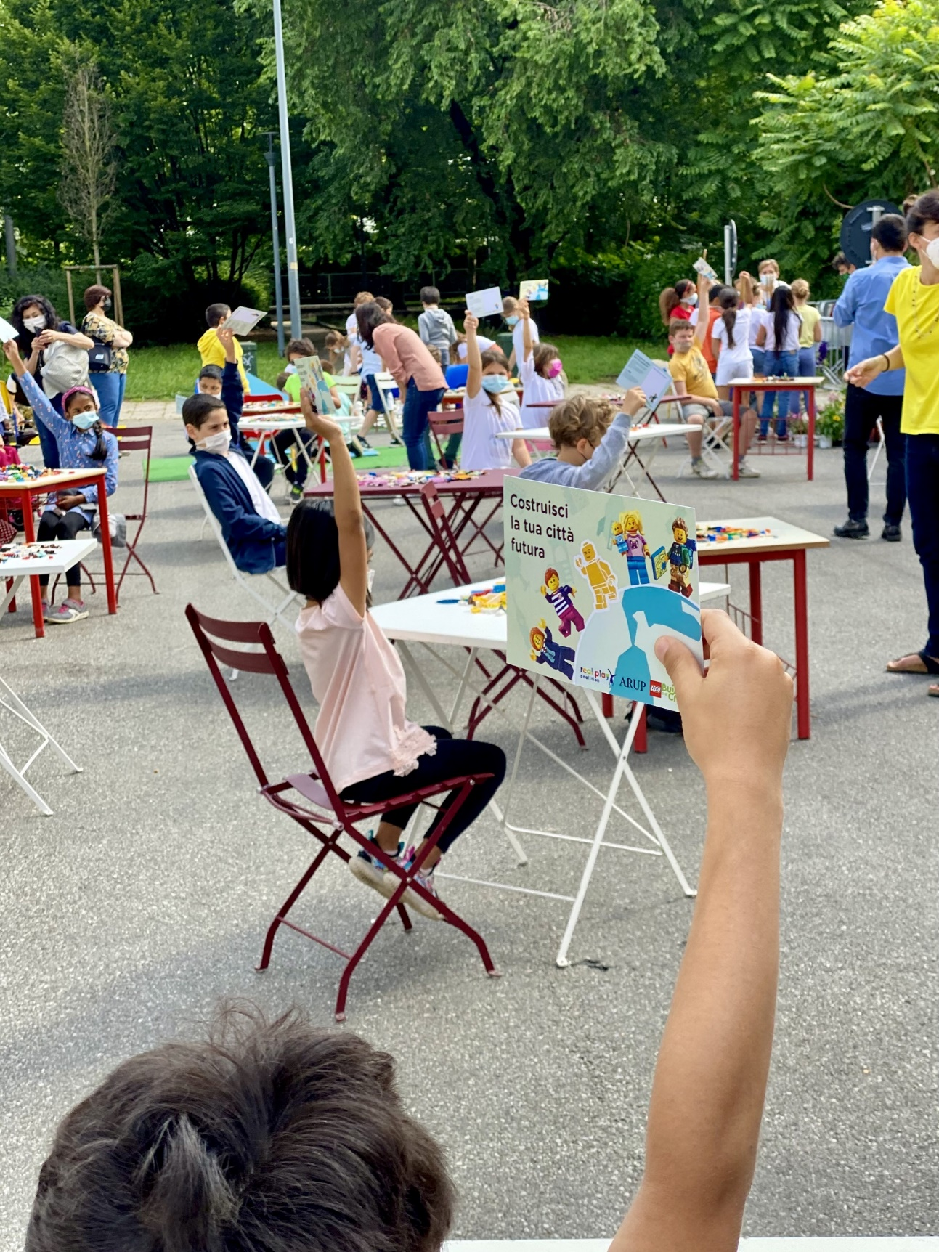
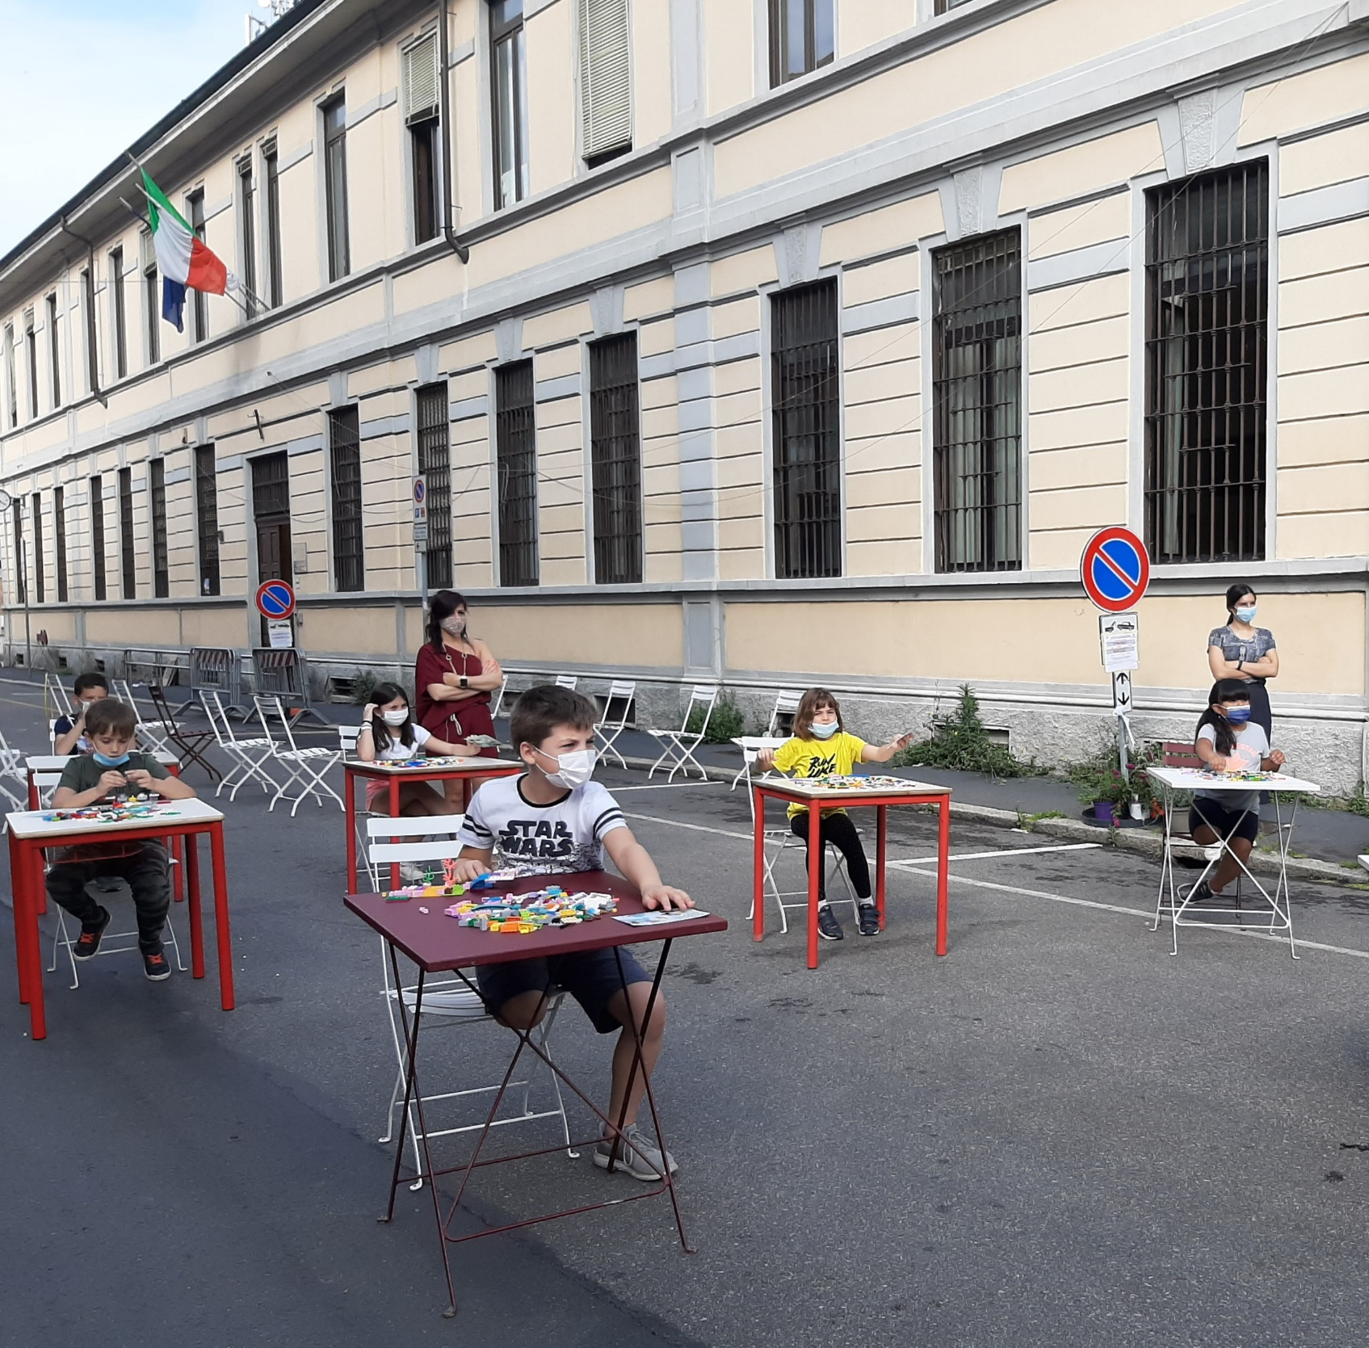
Notes:
Reclaiming Play in Cities is a research developed by Arup Milan and London offices, in partnership with Real Play and in collaboration with Milan Municipality. Real Play is a global non-profit coalition created in 2018 with the ambition to “change perceptions around the value of play, mobilise decision makers, influence behaviour change and eliminate the play deficit for children, for their optimal development and learning”. The aim of the research is to identify opportunities and criticalities of play in Rogoredo neighborhood, and
promote design development schemes and guidelines to increase the role and value of play for children and all the community.
Reclaiming Play in Cities is a research developed by Arup Milan and London offices, in partnership with Real Play (lego foundation) and in collaboration with Milan Municipality. Reclaiming Play in Cities was developed by Arup and the LEGO Foundation for the Real Play Coalition, and reviews the evidence around learning through play and the impact that urban environments have on children’s access to play and ultimately, their overall development

Slide 18
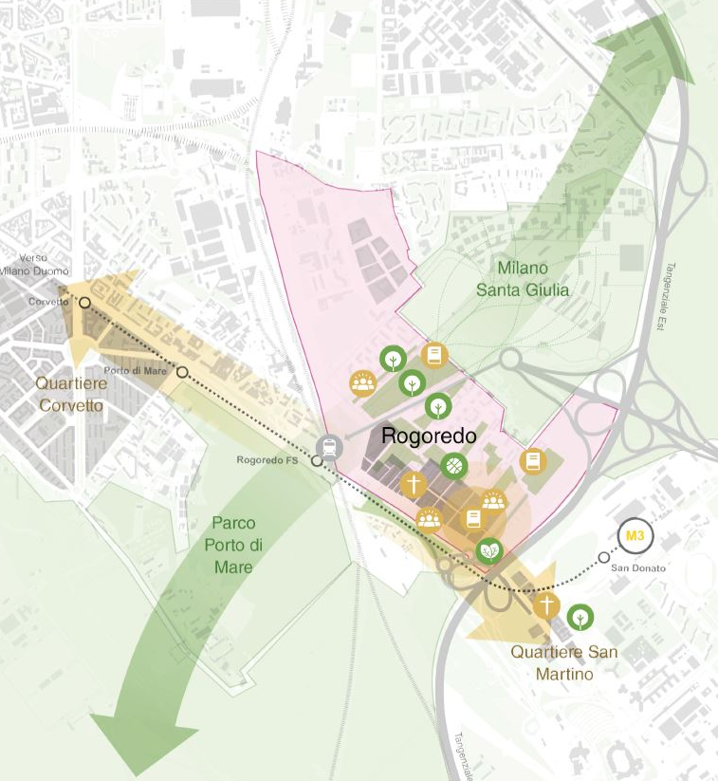
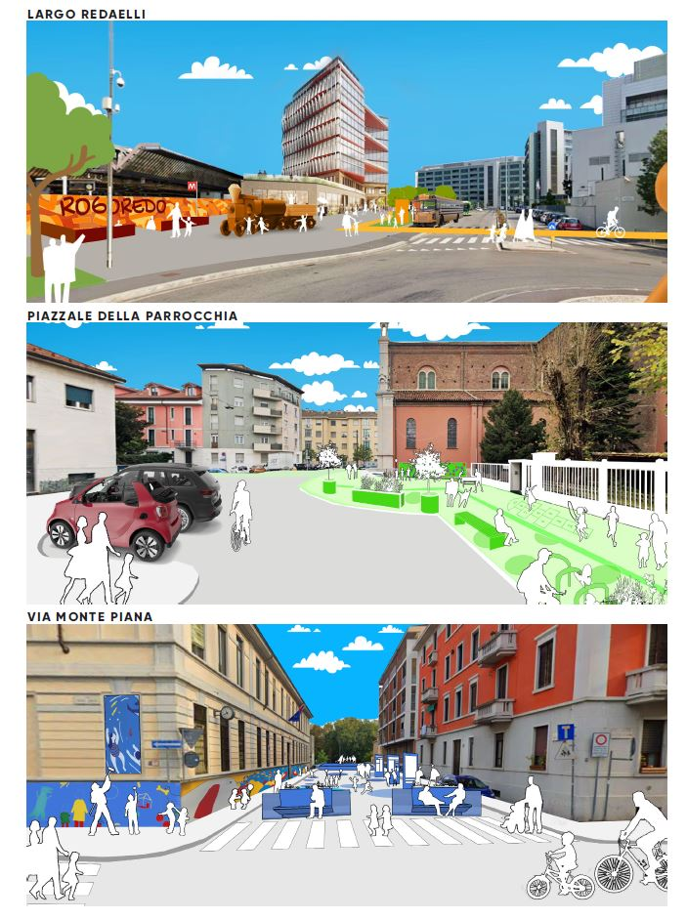
Reclaiming Play in Cities | Rogoredo, Milan, Italy
What we did and how
Global non-profit coalition
Research’s participated process
Opportunities and criticalities of play in Rogoredo neighborhood
Guidelines to increase the role and value of play for children and all the community
Community engagement activities, such as surveys, interviews, focus groups, workshop etc.
Notes:
We organized 2 workshops with kids from school in Rogoredo district in order to brainstorm with them idea of future city suitable for children. The built environment is a critical play and learning resource for children. Cities offer opportunities to better realise the potential to learn through playful experiences, by harnessing children’s innate curiosity through play, learn and practice the relational skills that enable our communities and society to be adaptable, sustainable and flourishing.

Slide 19
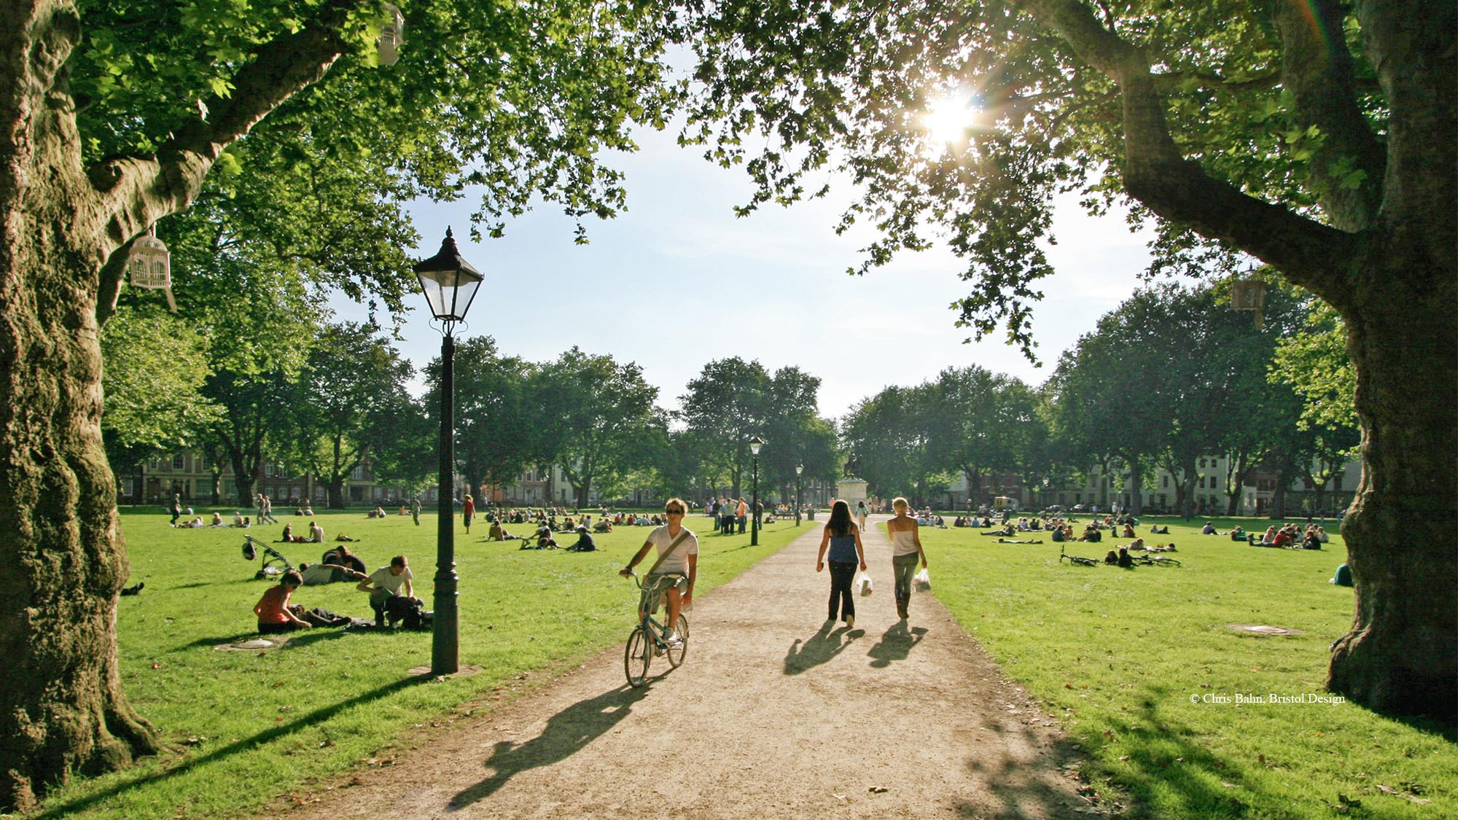

Slide 20
Thank you!
Lean Doody, Arup
Director Cities, Planning & Design, Europe
Lean.doody@arup.com

Slide 21
Notes:
What does the NEB Lab do? https://europa.eu/new-european-bauhaus/about/neb-lab_en
The NEB Lab is a project-based structure where teams self-organise to achieve tangible change in a specific place or context.
The New European Bauhaus Community and EU institutions autonomously develop projects proposals for the NEB Lab. Proposals become NEB Lab projects following a process that ensures a clear purpose, transparency towards the community, and well-defined beneficiaries.
The NEB Lab:
Ensures coherence across projects and alignment with the New European Bauhaus principles.
Supports project development by challenging proposals, connecting projects with the community and institutions for additional support, and bridging local action with the European and international dimension.
Offers projects space on a dedicated online platform, mentoring and communication support.
The NEB Lab does not provide funding for projects, however project teams can consider support and financing options, e.g. support in kind, EU, national, regional or local public funding, sponsorship.
What are the key characteristics of NEB Lab projects?
NEB Lab projects are developed autonomously by a team of project coordinators and may receive support from several entities beyond the official New European Bauhaus Community. They count on independent experts and are expected to deliver change on the ground.
NEB Lab projects:
Create or replicate beautiful, sustainable, inclusive places, products or experiences or enable initiatives to achieve that.
Provide results that are practical and replicable.
Are change processes that benefit communities and ecosystems.
Are based on international and cross-sectoral partnerships.
Inform the policy-making processes with their outputs, outcomes, and learnings.
Offer open-source learning opportunities for Community members.
Use participatory design methods and tools and draw on cross-disciplinary competences.

Slide 22
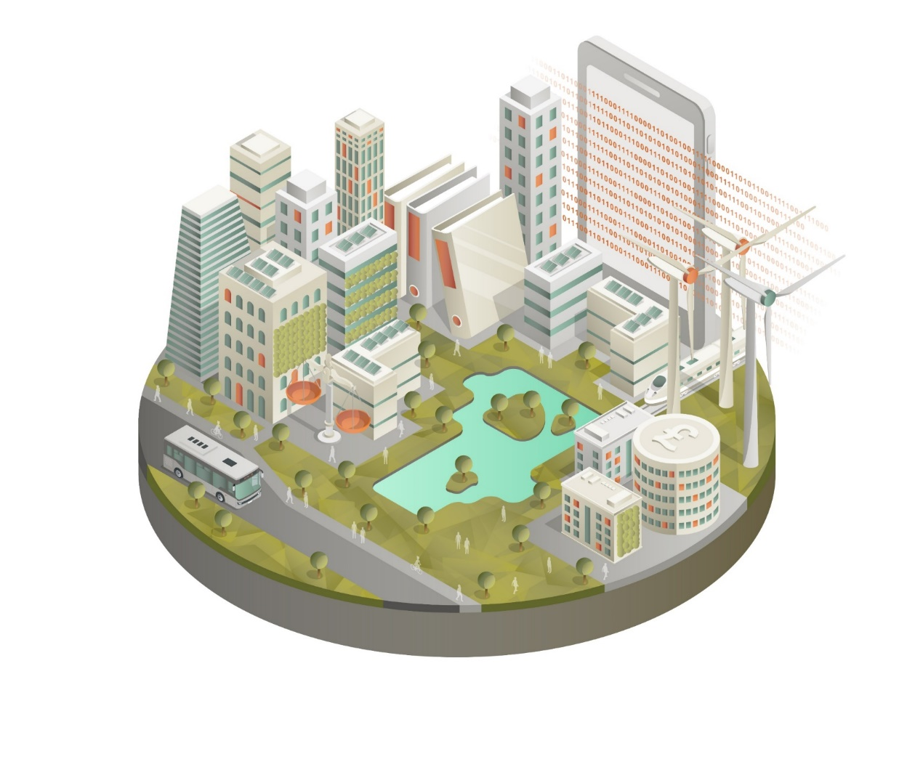
Sustainable Cities
Skills developed with communities
Enabled by data
Urban food systems developed
Prioritising renewables
Regenerative by design
Changing the economics
Supporting active travel
A just transition
source: Arup
Notes:
At the urban level, a number of systemic transformations are require to occur at scale for a sustainable city to transpire.
These transitions are supported by a number of approaches, from behavioural changes and practices, to regulation and policy as well as the business case for sustainability and the net gain for transitions.

Slide 23
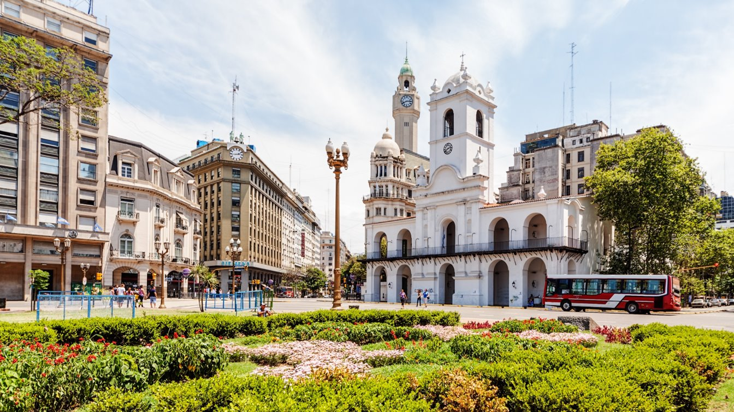

Slide 24
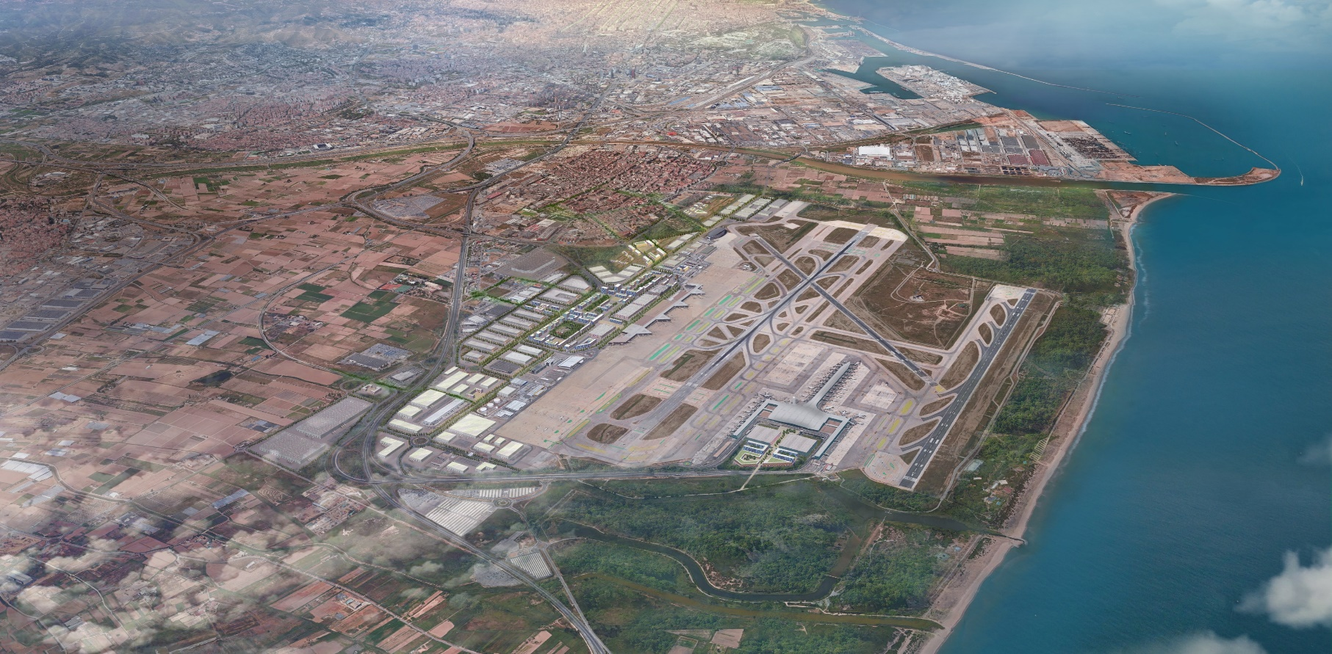
El Prat Airport masterplan | Barcelona, Spain
The project at a glance
New Barcelona airport sustainable expansion
The project develops detailed real estate masterplan, including urban and infrastructure design, airport and economic planning and environmental consultancy in looking to create an airport that is both smart and sustainable.
Due to its location in a high-quality environment and proximity for sensitive environmental areas, Barcelona airport has a unique character that allows for a reconsideration of the traditional concept of an airport and proposes very diverse activities.
Notes:
The vision developed by Arup for Barcelona-El Prat airport’s marketable terrains focuses on strengthening the existing qualities of the area. The project comprises 1,533ha of airport surface, of which 543habelong to the landside. The proximity to the metropolitan area alongside its strategic location next to the Logistics Activities Zone (ZAL) and Barcelona Port, favours he creation of an activity hub that takes into account the surrounding activities and reinforces the activity generated in the airport node. What ́s more, due to its location in a high-quality environment, Barcelona airport has a unique character that allows for a reconsideration of the traditional concept of an airport and proposes very diverse activities.

Slide 25
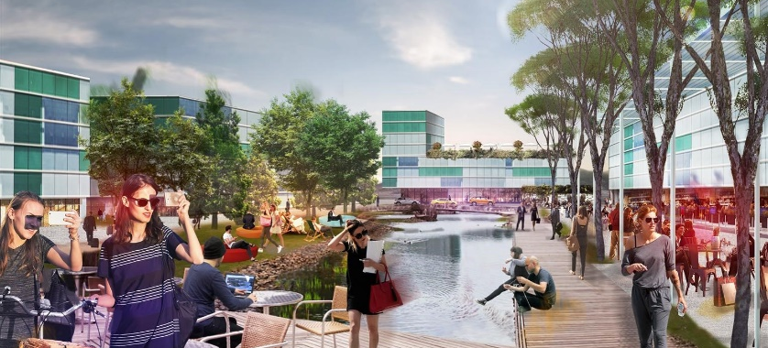
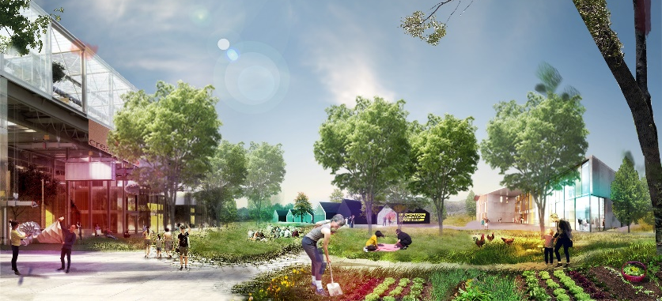
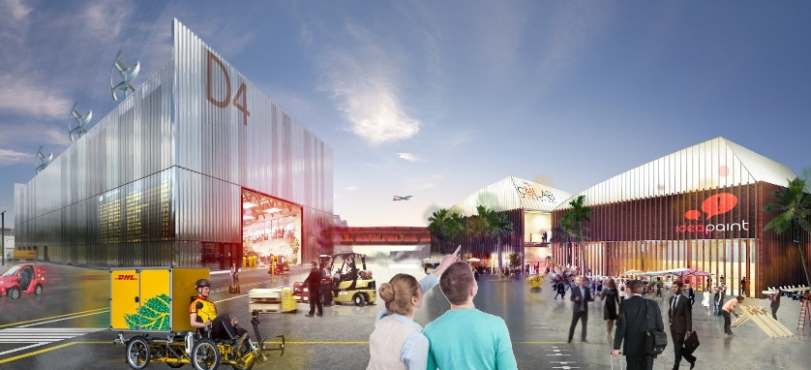
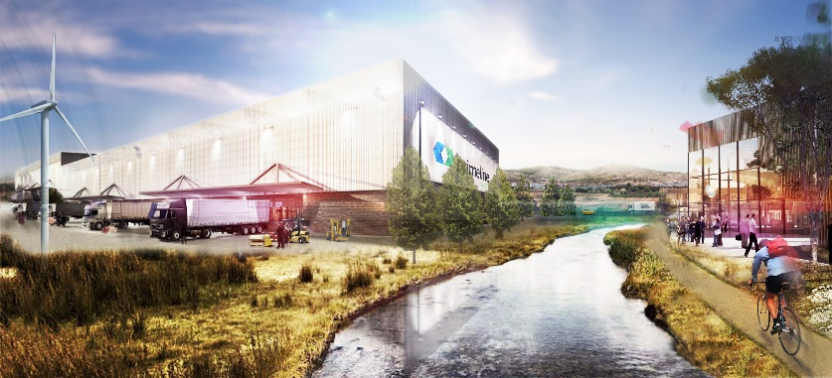
El Prat Airport masterplan | Barcelona, Spain
What we did and how
Expansion of new functions using nature-based solution elements
Office zone planned as ‘green business farm’
Dealing with naturalistic context by minimizing impact of ‘infrastructural presence’
Implementing green areas with high levels of biodiversity
Notes:
The airport’s location is nearby sensitive green areas, so the project aims to mitigate impact of ‘infrastructural presence’. Office zone planned as ‘green business farm’ together with light industry 4.0. This part of the masterplan offers various green areas of biodiversity, community gardens, social gathering points, greenhouse for social activities and learning.

Slide 26
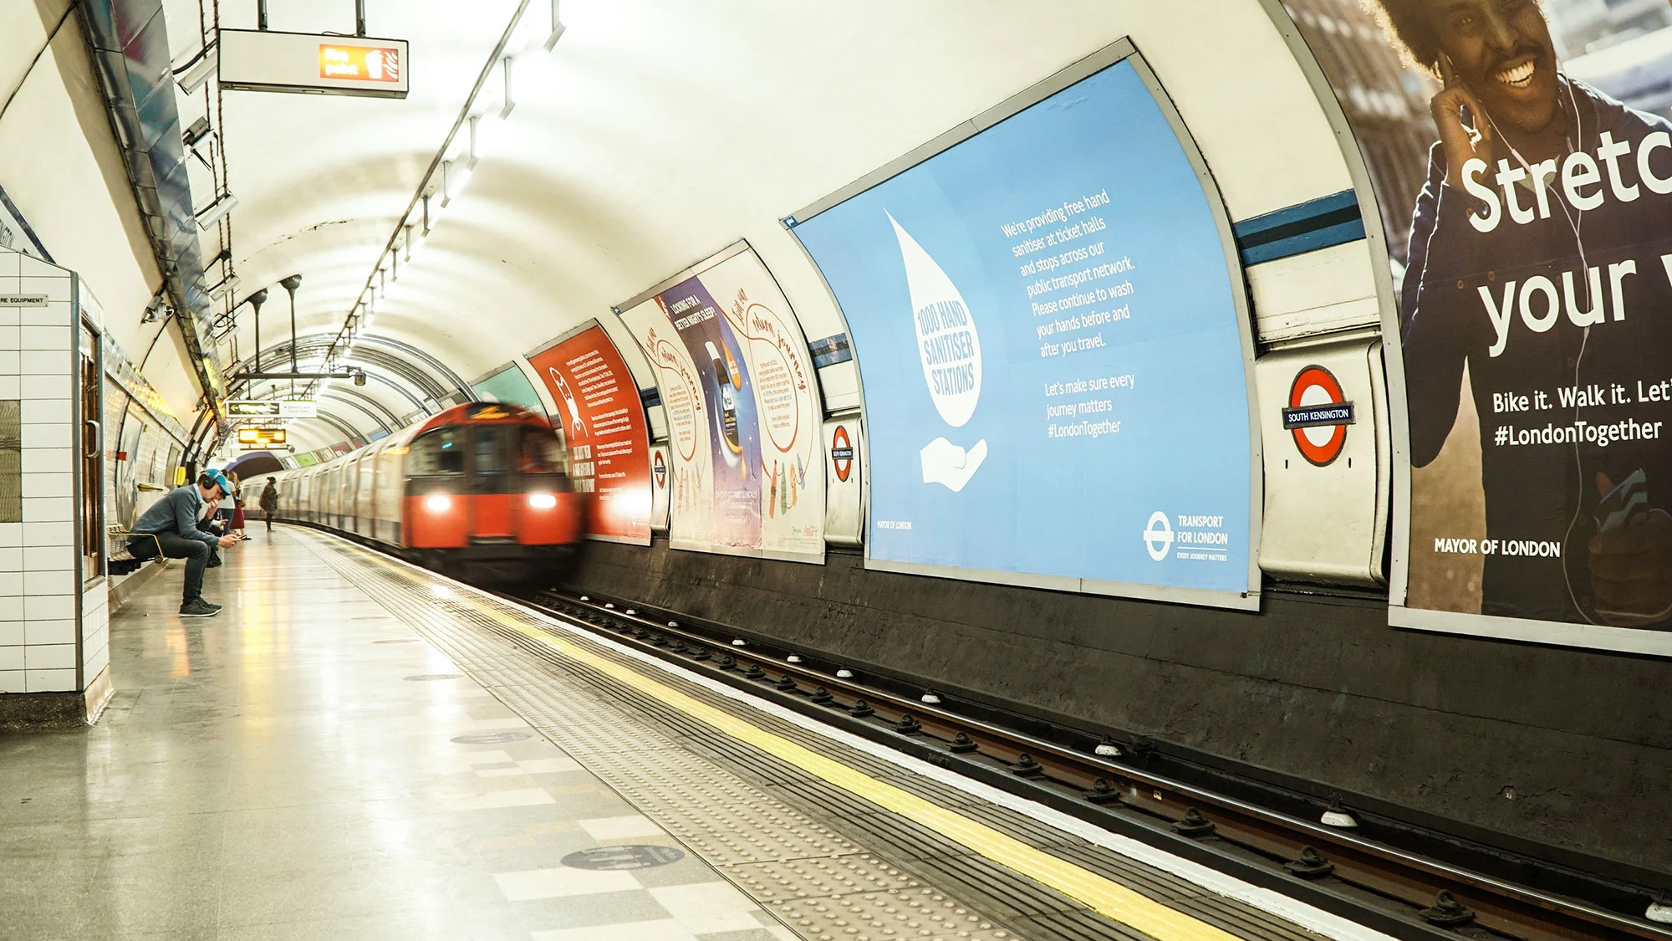

Slide 27
New European Bauhaus
A creative and interdisciplinary initiative that connects the European Green Deal to our living spaces and experiences
It aims to bridge the world of science and technology, art and culture and to leverage our green and digital challenges to transform our lives for the better
It is an invitation to address complex societal problems together through co-creation.
Three leading values:
Enriching - inspired by art and culture, responding to needs beyond functionality
Sustainable - in harmony with nature, the environment, and our planet
Inclusive - encouraging a dialogue across cultures, disciplines, genders and ages
Three key interconnected transformations:
Of places on the ground
Of the environment that enables innovation
Of our perspectives and way of thinking
Notes:
The New European Bauhaus is a creative and interdisciplinary initiative that connects the European Green Deal to our living spaces and experiences - it is a creative and transdisciplinary movement in the making.
It aims to bridge the world of science and technology, art and culture and to leverage our green and digital challenges to transform our lives for the better.
It is an invitation to address complex societal problems together through co-creation.
By creating bridges between different backgrounds, cutting across disciplines and building on participation at all levels, the New European Bauhaus inspires a movement to facilitate and steer the transformation of our societies along three inseparable values:
Enriching - inspired by art and culture, responding to needs beyond functionality – NOTE: some communication seems to refer to this pillar as Aesthetics but on the EC home page it is Enriching?
Sustainable - in harmony with nature, the environment, and our planet
Inclusive - encouraging a dialogue across cultures, disciplines, genders and ages
Moving forward, the New European Bauhaus movement will focus on three key interconnected transformations:
of places on the ground
of the environment that enables innovation
of our perspectives and way of thinking
Through a diffusion of new meanings, the New European Bauhaus sets out to question our mind-set around the values of aesthetics, sustainability and inclusion and involving artists, social scientists, educators, cultural and youth organisations in addressing the socio-economic and environmental challenges of our times.
https://europa.eu/new-european-bauhaus/about/delivery_en

